Slide 1



Optical, Wireless, and Optical Wireless Communication and a Brave Startup
光、无线、及光无线通信，和一个勇敢的初创公司
C. Patrick Yue 俞捷 Hong Kong University of Science and Technology
OWL ICDC ECE

Slide 2
Outline
Optical, Wireless, and Optical Wireless – What? Why?
Optical-Electronic Integrated Circuit (OEIC)
CMOS mmWave Phased-Array IC
High-SPLIQ IC for 6G Era
New Potential Applications in the 6G Era
Summary

Slide 3
Optical, Wireless, and Optical Wireless
Copper: high loss, low bandwidth
Fibers: low loss, high bandwidth, need OE-EO
Optical for Distance X Data Rate > 100 Gb/s-m
Cross-over opportunities!!
High-Speed OWC, Short-Reach Optical

Slide 4
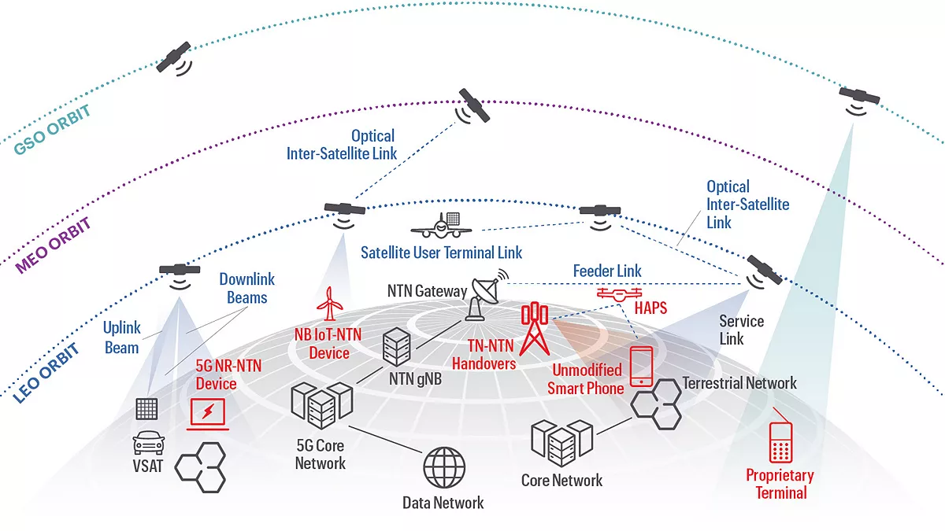
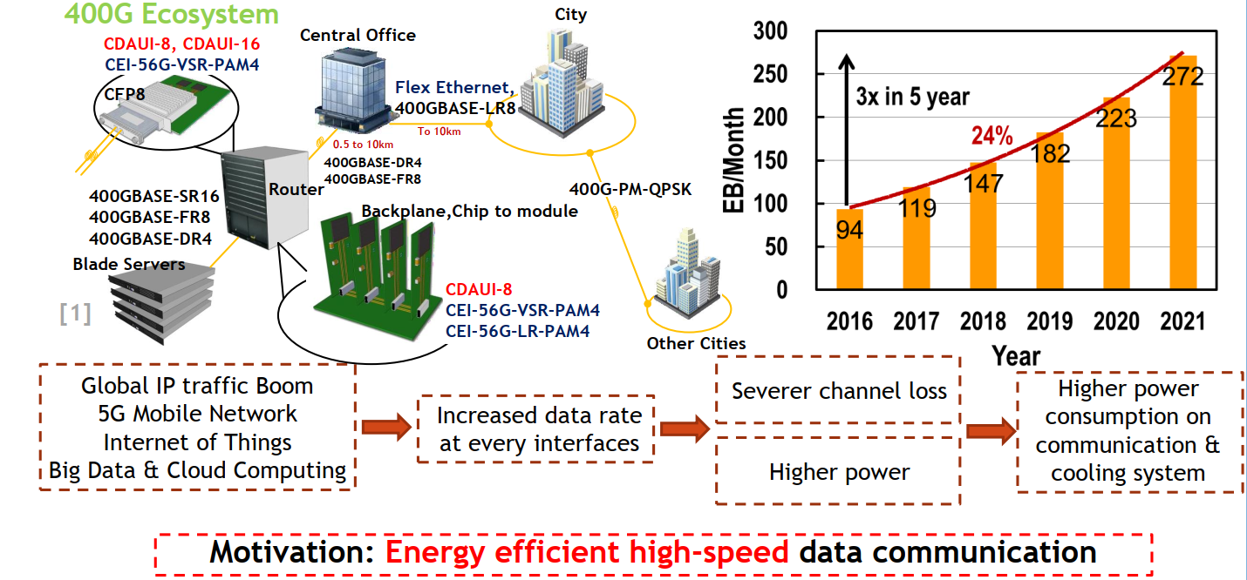
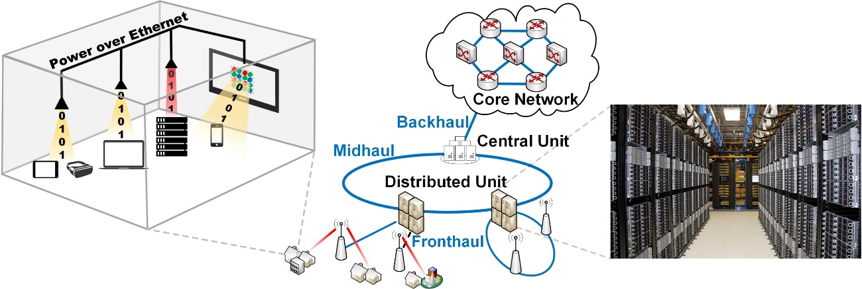
Ethernet Wireline Link
(Source: Texas Instruments,2022)
Non-terrestrial networks (NTN)
High-SPLIQ IC and SiP required in advanced enterprise communication applications
Optical fiber network for 5G network back-, mid-, front-haul connectivity

Slide 5
Optical-Electronic Integrated Circuit (OEIC)

Slide 6
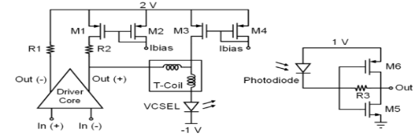
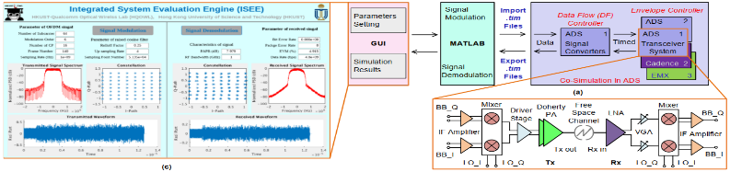
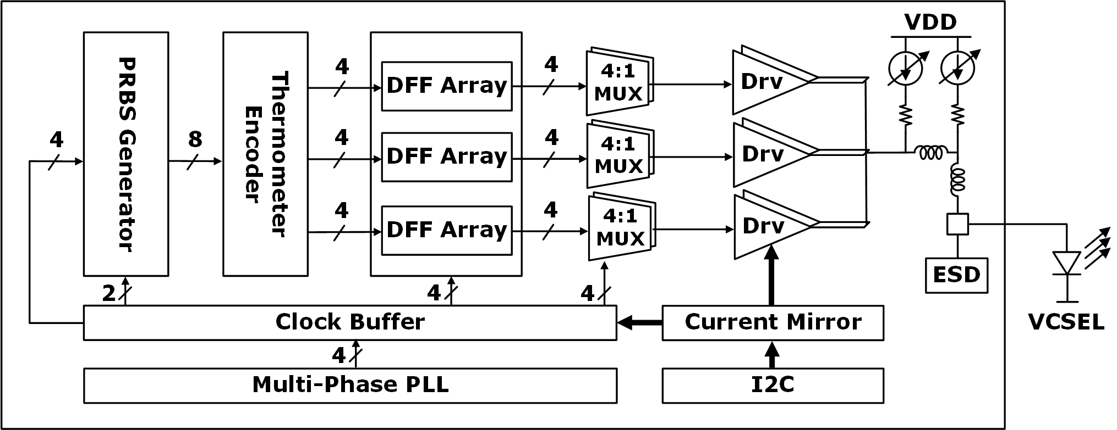
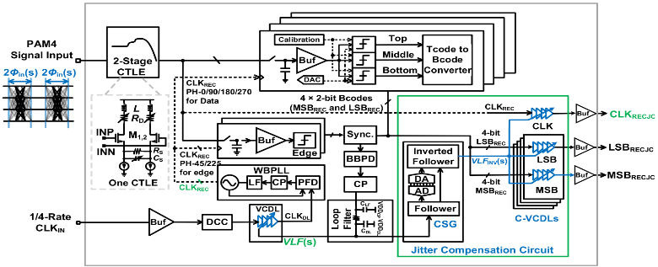
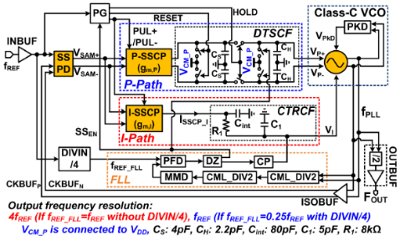
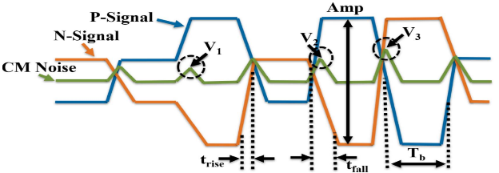
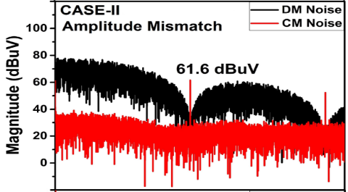
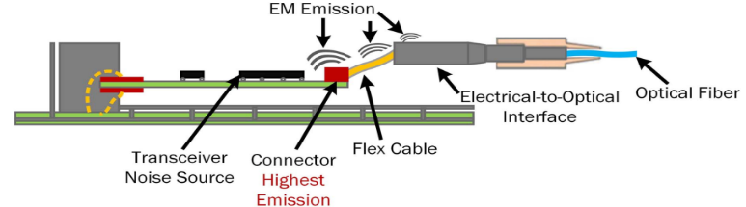
CMOS Optoelectronic Interconnect Chip: Architecture Design
Fully-Integrated System Architecture Design and Verification
Top-down system simulation to clarify specifications for each module
Multi-chip system simulation throughout the entire design cycle
Support complex modulation scheme, like PAM-4, OFDM, QAM
56-Gb/s PAM4 TX
Data path implements VCSEL nonlinearity compensation
Clock path has on-chip PLL
56-Gb/s PAM4 RX
Signal equalization in frequency domain
PAM4 signal decoding and clock recovery
14-GHz PLL
Sub-sampling PLL achieves low jitter
Low supply voltage to decrease power
PAM4 Optoelectronic Interconnect Chip EMI Analysis and Cancellation
Clarify radiation theory of CM noise
Propose close-loop controlling of CM noise
Propose CM noise cancellation circuit

Slide 7



课题负责人：俞捷
课题汇报单位：香港科技大学
参与单位：
华南理工大学、南方科技大学
2024. 01. 22

Slide 8



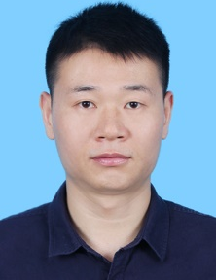



项 目 分 工
研究内容
项目实施
PAM4光电互联芯片整体设计
PAM4光电互联芯片整体设计
统筹项目工作计划和进度总体控制。负责组织课题工作的汇报、检查和验收
香港科技大学
俞捷教授
PAM4光电互联芯片发射端信号失真补偿
华南理工大学
陈志坚高工
协助承担单位完成项目立项、中期审查、项目结题等工作
PAM4光电互联芯片接收器前端设计
南方科技大学
余浩教授
潘权教授

Slide 9
High-linearity 56-Gb/s PAM4 TX chip
Based on 4-to-1 MUX, including data path, clock path, and bias and control part
Data path: adopting thermometer code-based architecture for piecewise compensating E/O gain and bandwidth nonlinearities
Clock path: multi-phase PLL to generate 8-phase clock
On-chip PRBS for testing
8

Slide 10
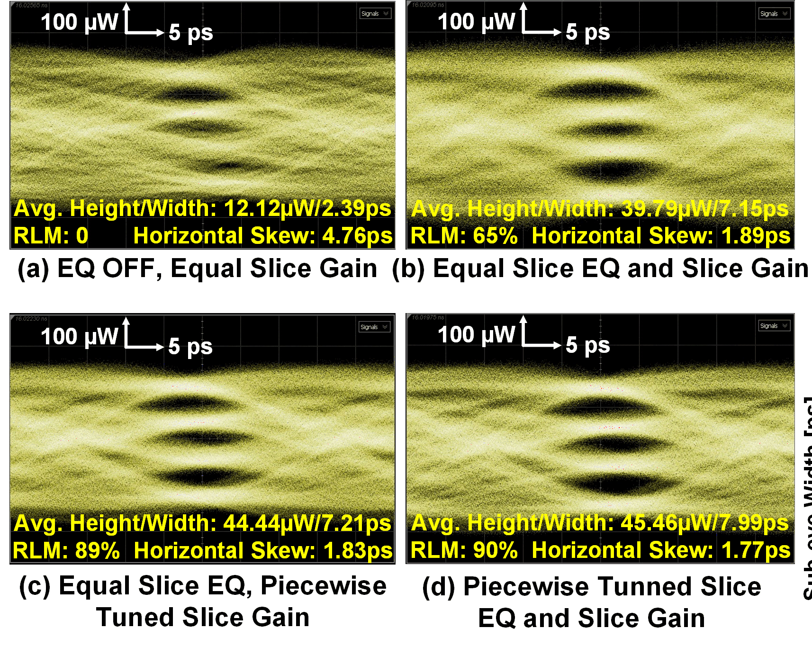
High-linearity 56-Gb/s PAM4 TX chip：4-2-1 MUX design
Implemented in 40nm CMOS，0.1 mm² of core area
Tuned slice EQ and slice gain to compensate for the VCSEL nonlinearity

Slide 11
测试指标（经第三方检测报告认定）与任务书指标对比
技术指标名称 | 任务书指标 | 实测指标 | 是否满足
速率 | ≥ 56 Gbps | 56 Gb/s | 完成
功耗 | < 400 mW | 152 mW | 完成
测试指标（经第三方检测报告认定）与国内外领先技术对比
 | PTL’18 | JSSC’22 | VLSI’19 | ASSCC’21 | This work
Technology [nm] | 65 | 40 | 65 | 40 | 40
Signalling scheme | 1/2-rate PAM-4 | 1/4-rate PAM-4 | 1/4-rate PAM-4 | 1/4-rate PAM-4 | 1/4-rate PAM-4
Date rate [Gbps] | 50 | 56 | 64 | 64 | 56
OMA [mW] | 2.00 | 0.81 | 2.50 | 1.08 | 1.18
Power effi. [pJ/b] | 5.12 | 1.73 | 2.69 | 2.09 | 2.05
Core area [mm²] | 0.31 | 0.47 | 0.28 | 0.16 | 0.10
Asymmetric equalization | 2.5-tap DAC-based FFE | 2-tap DAC-based FFE | 3-tap LSB/MSB-based Asymmetric FFE | 3-tap LSB/MSB-based Asymmetric FFE | 2-tap FFE + CTLE + Pre-emphasis
Nonlinearity compensation | Full | Full | Partial | Partial | Full
Method type | Digital | Digital | Analog | Analog | Analog

Slide 12
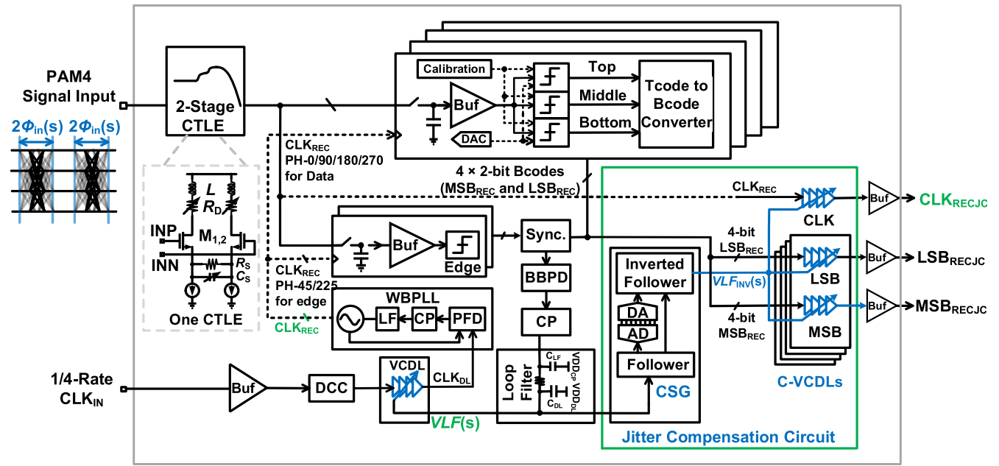
PAM4 RX: signal equalization, decoding, and clock recovery
Two-stage CTLE to compensate signal in frequency domain
¼ rate architecture，3 comparators to adjust top, middle, and bottom eyes separately
Clock generated by DLL CDR, adopts jitter compensation to improve quality of output data

Slide 13
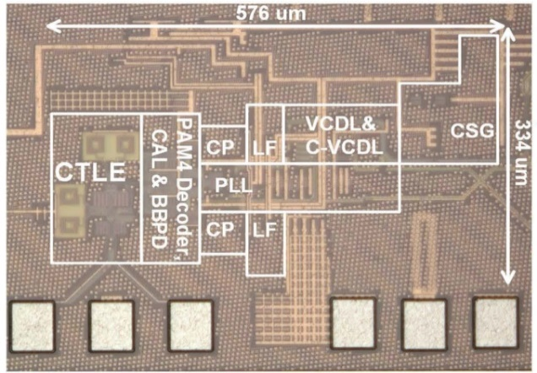
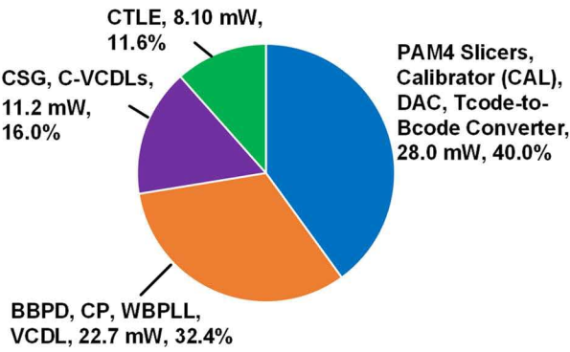
PAM4 RX: signal equalization, decoding, and clock recovery
Implemented in 40nm CMOS technology，0.58 x 0.34 mm² of core area
Error-free under 60-Gb/s with PRBS7/15, 70.8 mW of total power
Die photo
Bathtub curve
Power breakdown
Eye diagram of output clock under ¼ rate
Eye diagram of output MSB under ¼ rate
Eye diagram of output LSB under ¼ rate
12

Slide 14
测试指标（经第三方检测报告认定）与任务书指标对比
技术指标名称 | 任务书指标 | 实测指标 | 是否满足
速率 | ≥ 56 Gbps | 60 Gb/s | 超额完成
功耗 | < 400 mW | 70.8 mW | 超额完成
测试指标（经第三方检测报告认定）与国内外领先技术对比
 | JSSC’19 | JSSC’19 | VLSI’14 | JSSC’17 | VLSI’14 | This work
Technology | 28-nm | 40-nm | 65-nm | 65-nm | 28nm | 40-nm
Architecture | 1/4-Rate NRZ | 1/4-rate NRZ | 1/4-rate NRZ | 1/4-rate NRZ Adaptive LPF BW in CDR | 1/4-rate NRZ Split path CDR | 1/4-rate PAM4, JCCDR
JTOL [UI_{PP}] @ 3dB bandwidth | None @ 1 MHz | 0.22 UIPP** @ 4 MHz | 0.1 UIPP @ 1 MHz | 0.41 UIPP @ 20 MHz | 0.2 UIPP @ 8 MHz | 0.2 UIPP 40 MHz
JTRAN [dB] @ 3dB bandwidth | None | 0 ~ -3 dB @DC ~ 4 MHz | 0 ~ -3 dB @DC ~ 1 MHz | 0 ~ -3 dB @DC ~ 4 MHz | 0 ~ -3 dB @DC ~ 3MHz | <-8 dB @All band
Data rate [Gb/s] | 2-pairs × 16 | 25 | 14 | 40 | 4-lanes × 40 | 60
Power [mW] | 2-pairs × 16.06 | 27*** | 7.8 | 225 | 4-lanes × 175 | 70.8
Power efficiency [pJ/bit] | 1.004* | 1.08*** | 0.56 | 5.625 | 4.375 | 1.18
Supply voltage (V) | 0.9 | None | 0.8 | 1.2 | None | 1.0

Slide 15
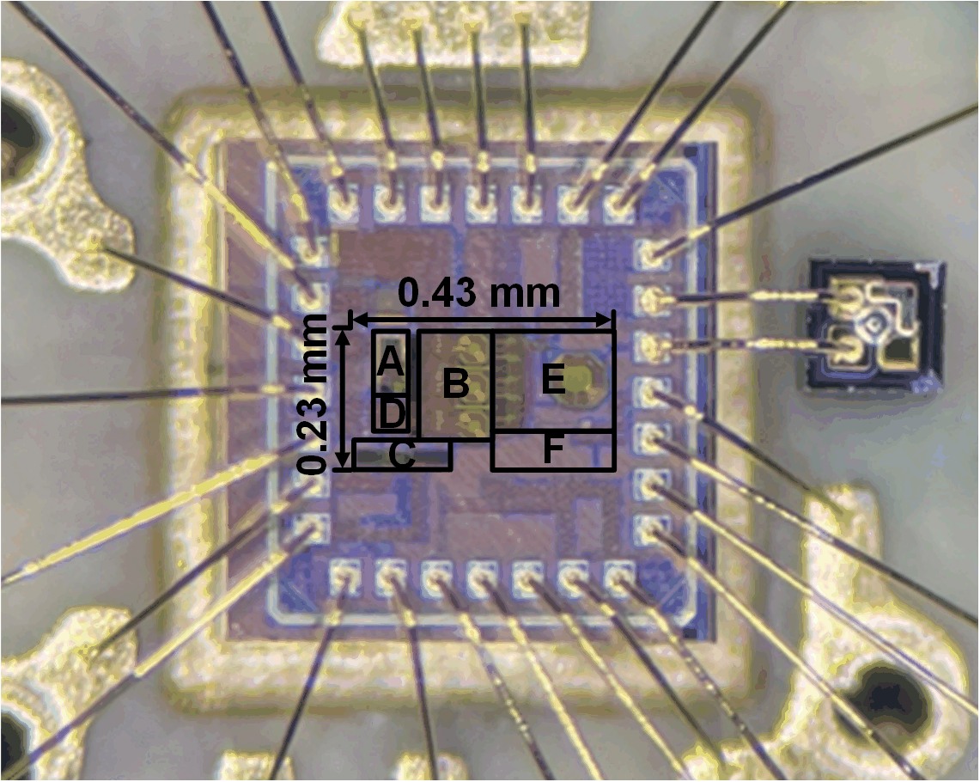

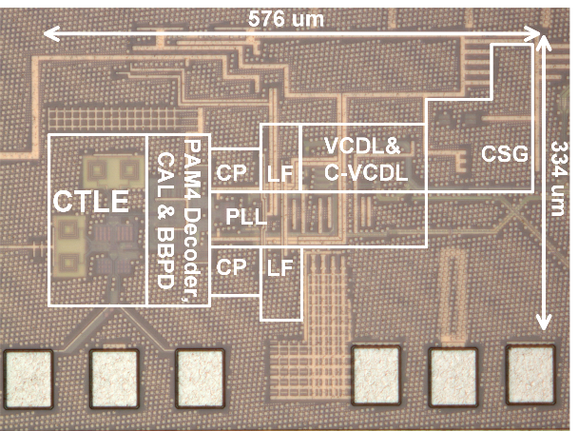
VCSEL TRX Demo：56-Gb/s PAM-4 VCSEL TX and RX
Link
PAM4收发机芯片演示视频 ESSCIRC 2023+VLSI2021 Fuzhan Li_哔哩哔哩_bilibili
QR code

Slide 16
CMOS mmWave Phased-Array IC

Slide 17
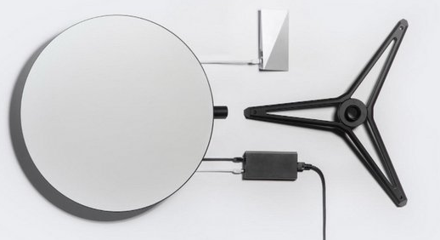
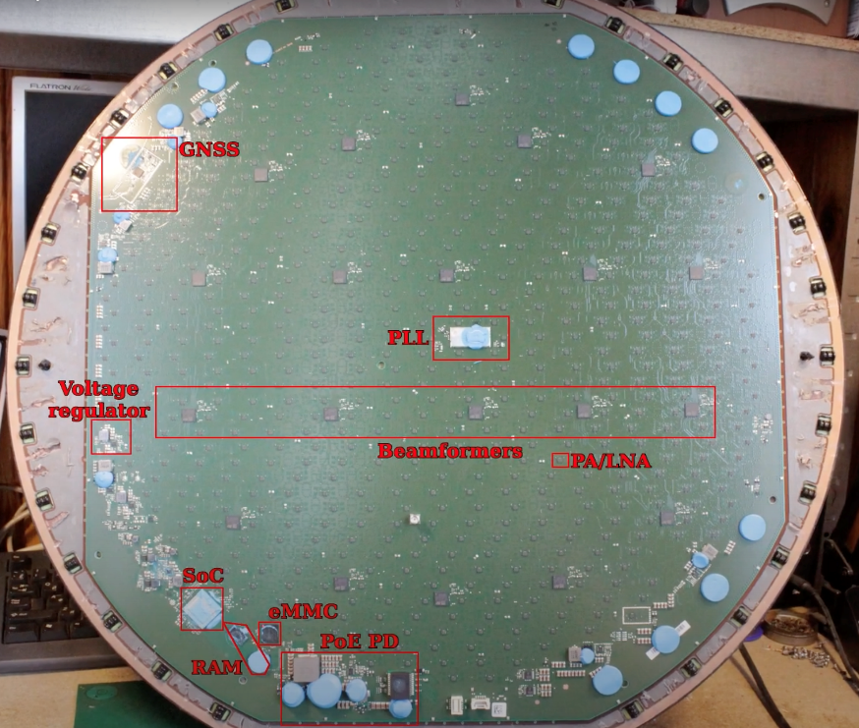
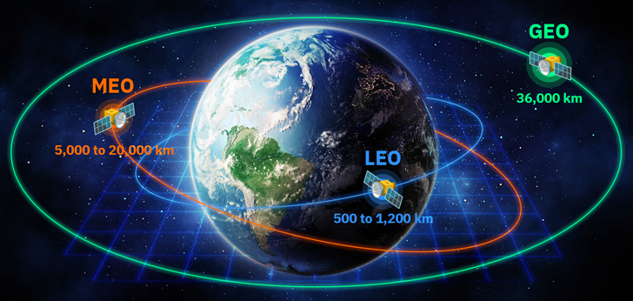
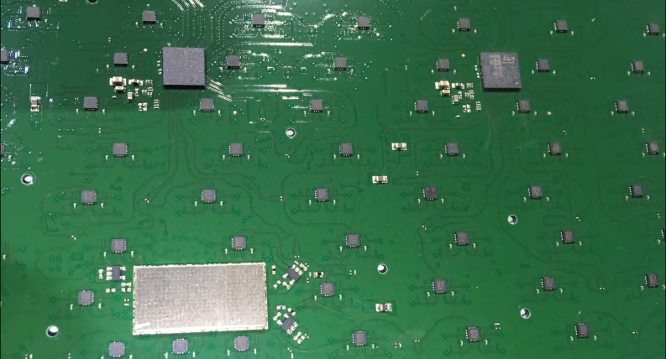
Starlink Satcom
Starlink Ground Dish
Mechanical satellite tracking employed
Utilization of electrical and digital beamforming
Architecture designed to minimize beamforming IC usage
Focus on combining individual PAs and LNAs for gain enhancement

Slide 18
A Ka-Band Phased-Array Tx SoC in 40nm CMOS

Slide 19
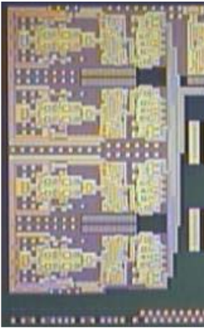
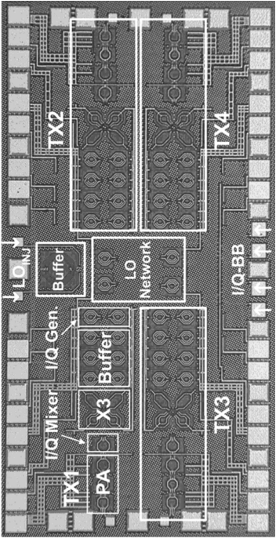
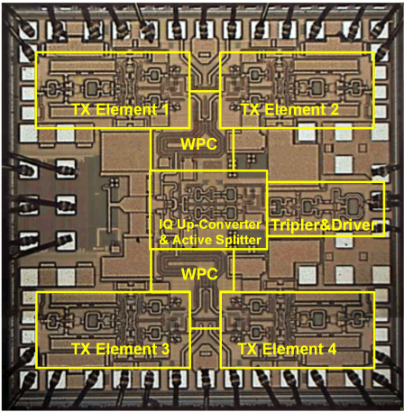
Area Efficiency Comparison
TMTT 2021, 38 GHz
4.3 x 2.2 mm²
w/o LO Gen.
JSSC 2010, 60 GHz
2.9 x 1.4 mm²
w/o LO Gen.
JSSC 2022, W band
2 x 2 mm²
w/o LO Gen.
This work, 28 GHz
1.87 x 1.16 mm²
with LO Gen

Slide 20
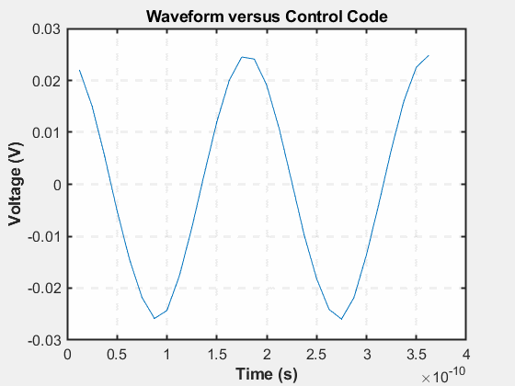
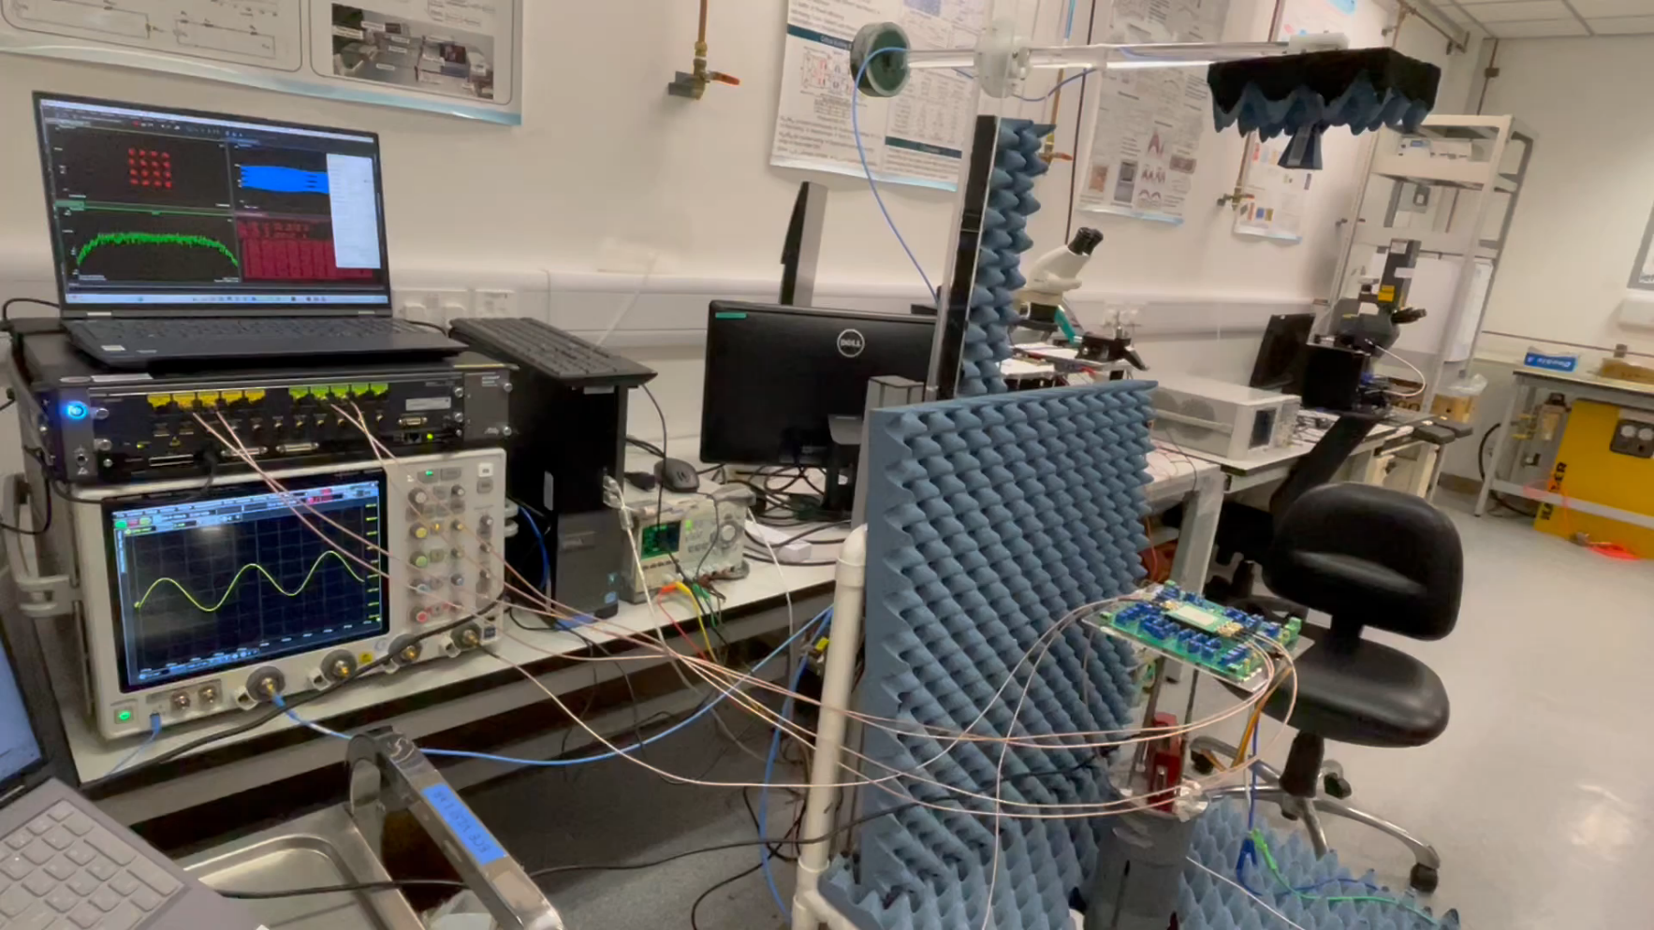
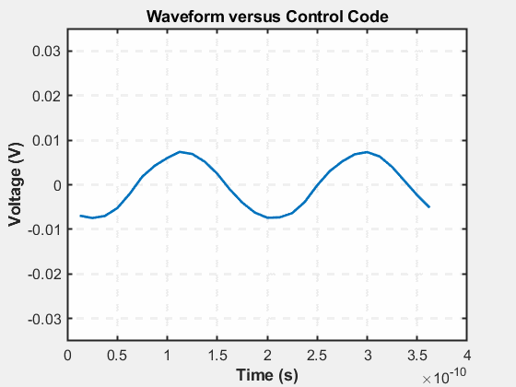
Phase Shift and Gain Control Demo
Orthogonal phase shift and gain control

Slide 21
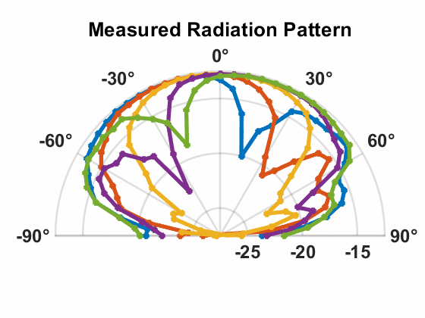
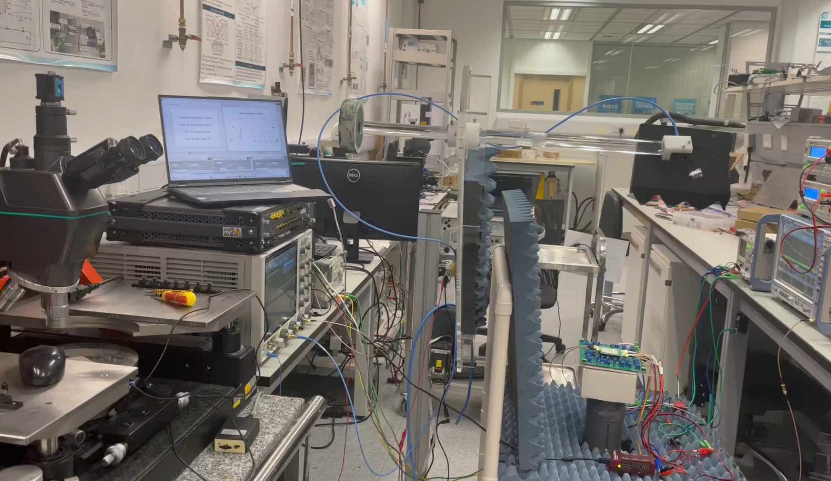
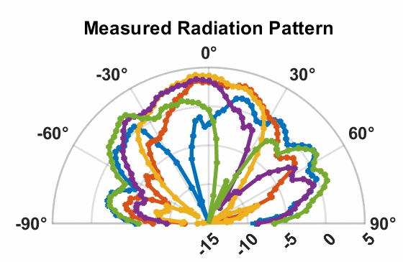
Beamsteering Demo

Slide 22
Ka-Band Cascaded QPLL

Slide 23
28GHz Dual-Loop PLL Architecture

Slide 24
Experimental Results
The 1st-stage RF SSPLL dominates the overall jitter
1st-stage contributes 54.4-fs out of 56.8-fs total rms jitter
High frequency VCO phase noise is sufficiently attenuated
Over 1 kHz to 100 MHz range, QVCO PN profile is well above QPLL

Slide 25
Performance Comparison
 | Hu ISSCC20 | EK JSSC18 | Yang ISSCC22 | Du VLSI21 | Kim JSSC19 | Liao JSSC20 | This work
Tech | 28nm | 28nm | 7nm | 28nm | 65nm | 45nm | 40nm
Arch. | CS + Harmonic extraction | Single-stage | Harmonic mixing | Harmonic extraction | Cascaded SS+QILO | Cascaded RSPLL+ ILFM | Cascaded SS+DP-SS
Freq. (GHz) | 21.71~ 26.49 | 23.3~ 30.2 | 25~28 | 24~31 | 28~31 | 33.6~36 | 24.0~ 29.8
Freq. range | 19.3% | 25.8% | 11.3% | 25% | 10.1% | 6.9% | 21.4%
Ref. (MHz) | 250 | 491.5 | 74 | 50 | 100 | 80 | 250
Jitter (fs) | 75.89 (10k~30M) | 114 | 88 | 199 (10k~30M) | 76 (1k~30M) | 251 (10k~10M) | 56.8 (1k~30M)
Spur (dB) | -45 | -65.1 | -61 | -65 | -58 | -60 | -55.6
Pdc (mW) | 16.5 | 31 | 12.9 | 11.5 | 41.8 | 20.6 | 42. 1
FoM_{jitter} (dB) | -250.2 | -244 | -250 | -243.3 | -246.1 | -238.9 | -248.6
FoM_{jitter-N} (dB) | -270.4 | -261.2 | -275.8 | -270.9 | -270.7 | -265.3 | -269.1
Area | 0.5 | N. M. | 0.24 | 0.3 | 0.32 | 0.41 | 0.4

Slide 26
High-SPLIQ IC Needed for the New Era

Slide 27
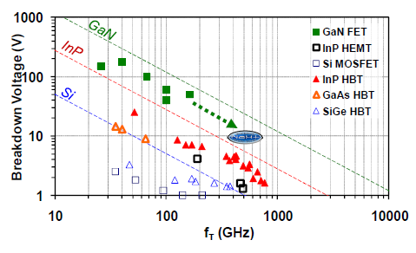
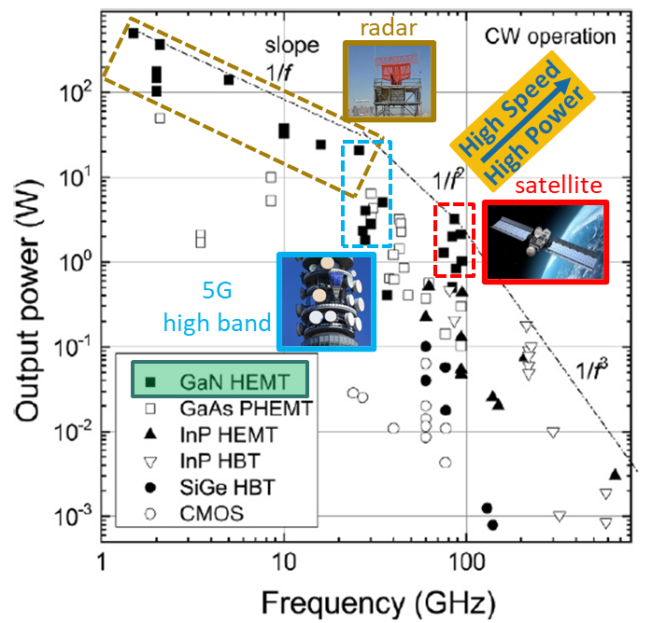
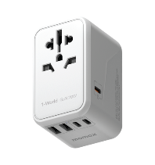
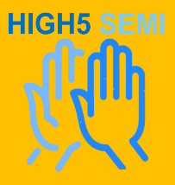
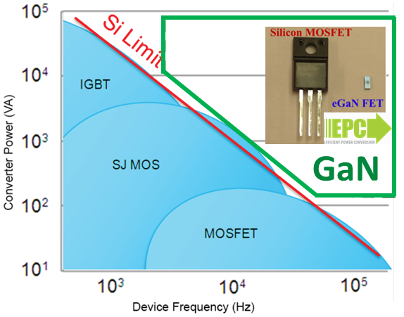
High-Speed High-Power
K. Shinohara, “III-Nitride millimeter wave transistors”, Chapter 4 in III-Nitride Electronic Devices, Elsevier (2019).
Charger and power supply
GaN for mmWave
J. Albrecht et al., IEEE CSICS (2010).
GaN for power management
I. C. Kizilyalli et al., “Wide band-gap semiconductor based power electronics for energy efficiency” (ARPA-E, Washington DC, 2018)
0.01
2025/10/22
High5 Semiconductor Ltd. Proprietary and Confidential. Protected under NDA. Copyright 2024.
26

Slide 28
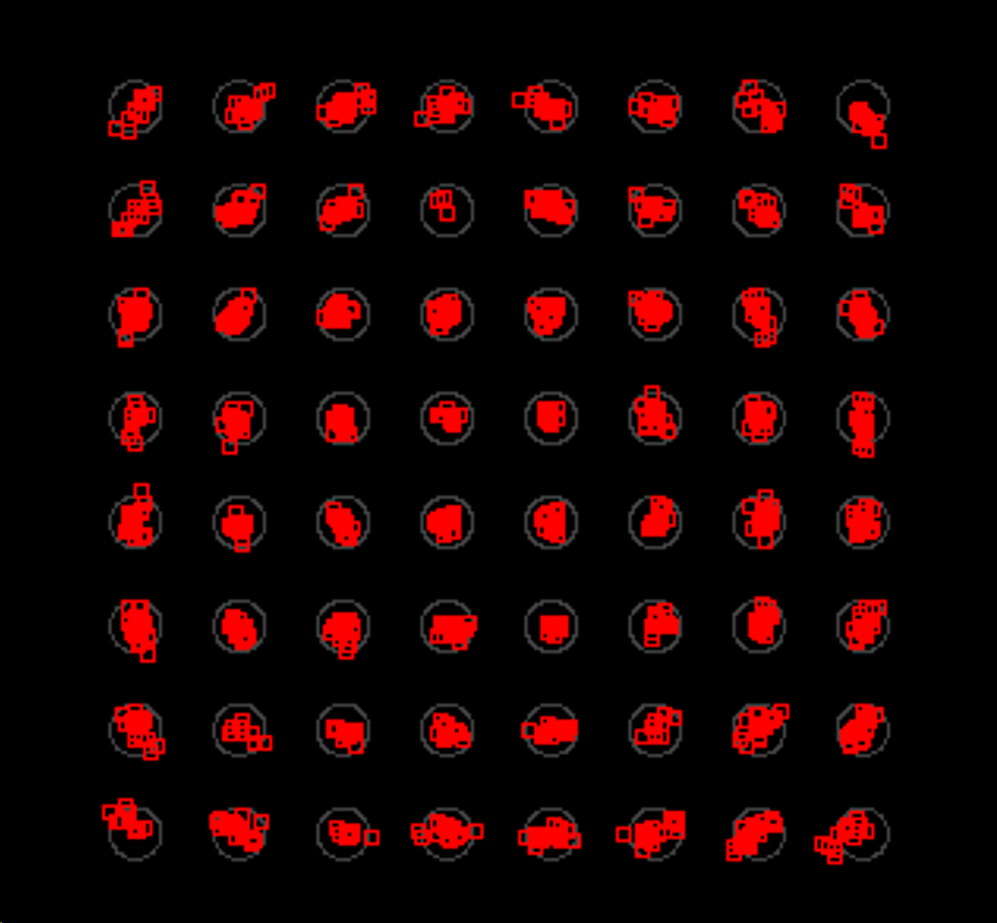
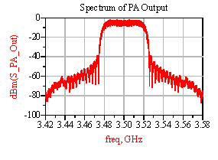
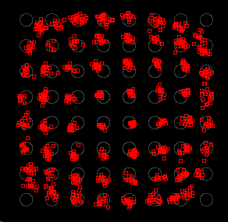
High-Linearity
QAM-64 constellation with low EVM
ACPR from ISEE
(Integrated System Engineering Evaluator),
a simulation platform developed by OWL)
Large signal performance of a mmWave power amplifier (PA),
including P_{out}, Gain and PAE
https://github.com/HKUST-ECE-IC-Design-Center-OWL/ISEE-Complex-Signal-Co-simulation-Platform-For-Intergrated-Circuit-and-System-Design
QAM-64 constellation with high EVM (bad linearity)

Slide 29
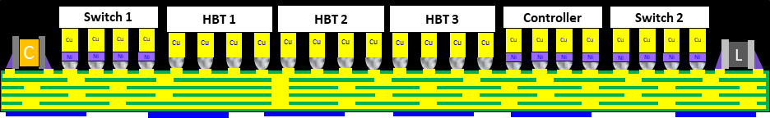
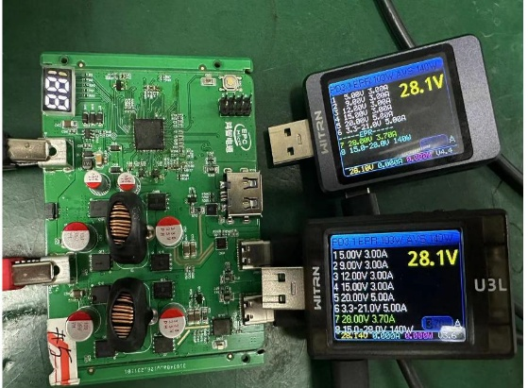
High-Integration
Compact Package
Designed to achieve highest-level of integration in a small form-factor and includes multiple functions IC with multiple processes
This RFFE SiP includes 56 SMDs, 9 Acoustic filters, 4 HBT PAs, 2 SOI Switches, 1 SOI LNA, and 1 CMOS controller
System-in-Package
DC-DC
GaN PA
CMOS TRx
SOI LNA
Controller
RF Switch
High power dissipation device like DC-DC converter and GaN PA in the same package
Multiple-tech chips in a single package
High-Voltage High-Power Buck Boost Converter
EPC 140W Micro SmartPower
Type-C Bidirectional PD3.1/Max 140W
Type-A multi-channel fast charging
Intelligent power allocation for multi-port high-power charging
Built-in dual DC-DC
Supports 2C1A independent fast charging
Supports dual PD3.1 simultaneous charging and discharging
Solar energy charging
28V-5A discharge; 28V-2A charge
Multiple over-voltage, over-current, and over-temperature protection

Slide 30
High-Quality Factor Passives
Directly using PDK inductor
L = 138 pH
Q = 33
Custom-design optimized inductor
L = 153 pH
Q = 47 (42% higher)
Trade-off between Q factor, inductance density, and power handling capability

Slide 31
New Potential Applications in the 6G Era

Slide 32
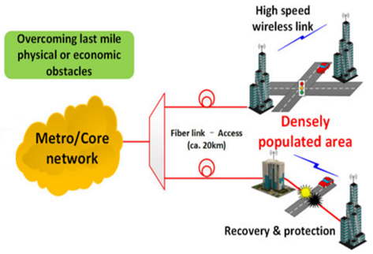
New Opportunities: Optical-Wireless Hybrid Link
Fiber-Wireless Hybrid Network: Cascaded Topology
Evolution of Cellular Networks
Fiber-Wireless Network
5G mobile network requires ultra-dense cellular cells
Backhaul links deployment is challenging
Fiber-wireless networks provide high performance and flexible backhaul link connections
[2] X. Pang, JLT 2014

Slide 33
New Opportunities: Optical-Wireless Hybrid Link
Fiber-Wireless Hybrid Network: Parallel Topology
Under good weather condition: mmWave + Optical in parallel
Under bad weather condition: mmWave only

Slide 34
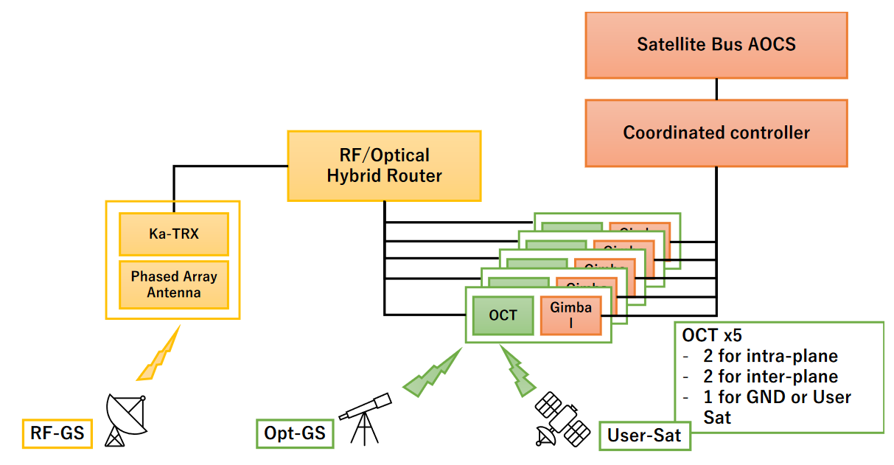
Optical-Wireless Hybrid Link for SatCom
Mixed usage of OWC and mmWave links for LEO SatCom
Optical: communication between satellites
mmWave: between satellite and ground base station
AOCS: Attitude and Orbit Control System
OCT: Optical Communication Terminals
[Okada. Tokyo Tech]

Slide 35
Optical-Wireless Hybrid Transceiver Architecture
Optical-In-mmWave-Out + mmWave-In-Optical-Out

Slide 36
6G Technologies & IC Design
Research @ HKUST

Slide 37


An Area of Excellence Project (AoE/E-601/22-R)
6G: Wireless Access and Connectivity for an Intelligent and Sustainable World
Coordinating
University:
Started Jan. 2023 and Supported by the Hong Kong Research Grant Council

Slide 38













The AoE Team
Communication
/ Signal
Processing
Networking
K. B. LETAIEF
R. MURCH
Qian ZHANG
V. N. LAU
Patrick YUE
Jun ZHANG
C. Y. TSUI
Song GUO
Electromagnetics / Antennas / IC Design
AI / Machine
Learning
A. ZHANG
Jiaya JIA
Multidisciplinary Team with Complementary Strengths
K. HUANG

Slide 39
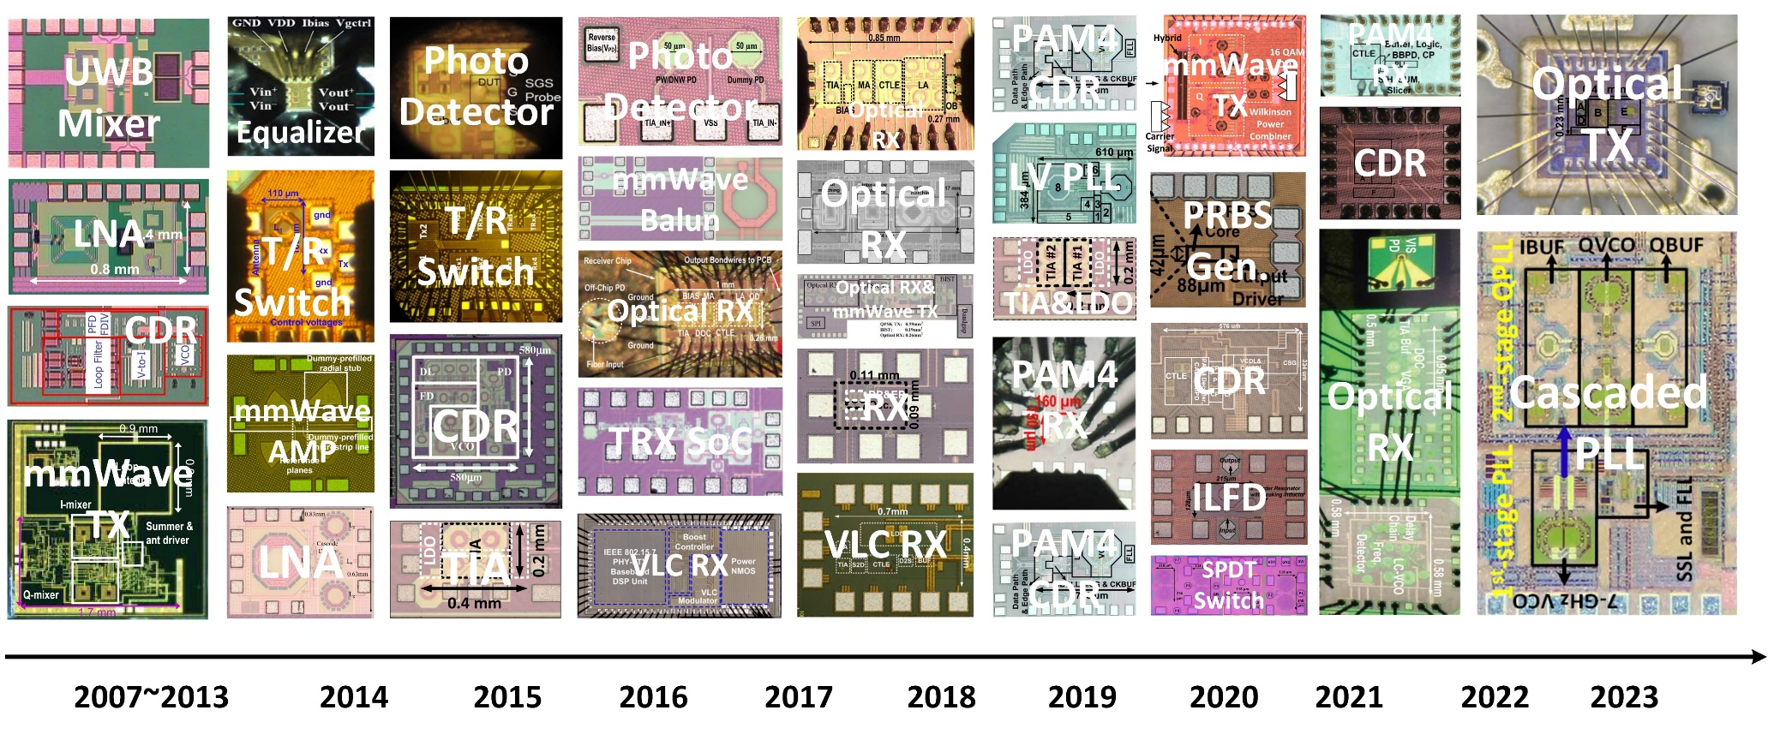
Optical Wireless Lab (OWL🦉) Chip Gallery

Slide 40

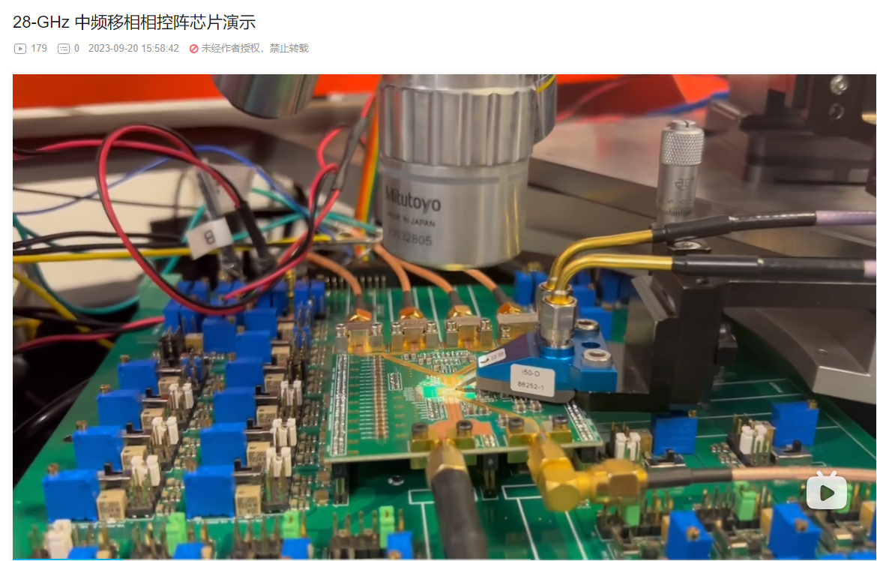
港科大光电无线实验室个人主页-哔哩哔哩视频 (bilibili.com)

Slide 41
谢谢!
Thank you!

