Slide 1

光、毫米波通信集成电路与初创企业
High5 Semiconductor (HK) Limited 高武半導體(香港)有限公司
Prof. C. Patrick Yue 俞捷, 香港科技大学
首届“湘智兴湘”大会 — 湖南 长沙
2025-09-19
Integrated Circuit Design Center, Optical Wireless Lab
Department of Electronic and Computer Engineering
The Hong Kong University of Science and Technology (HKUST)
Hi5 Semiconductor
High5 Semiconductor (Hong Kong) Limited
高武半導體(香港)有限公司

Slide 2
内容綱要
團隊成員與技術協同
市場機遇
技術路綫與目標市場
產品描述與原型
商務拓展

Slide 3


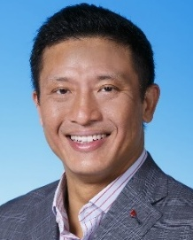
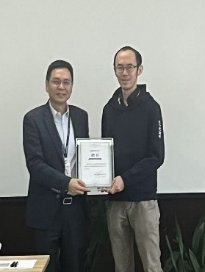
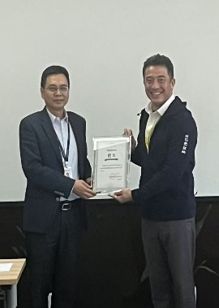

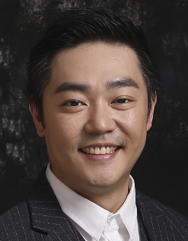
CMOS芯粒+GaN芯粒領域的綜合技術專長
Co-founder of Atheros, IPO in 2004
Developed First-gen Wifi products
Fellow, IEEE & Optica
HKUST IC Design Center Director
Expert in CMOS optical and wireless communication IC
Deep partnership GaN foundry Dynax
Process development and device optimization
Our CGTA Prof. Man Hoi Wong is an expert in wide-bandgap semiconductors
Prof. C. Patrick Yue
CMOS + GaN = High-End Eco-Semiconductor Chiplets
High-Energy Efficiency
Heterogenous integrated system-in-package (HISiP)
High-Speed
High-Power Efficiency
High-Linearity
High-Integration
High-Q-Factor Passives
Partnering with Faraconix on RF module integration
Jointly tackling heat and high-freq loss issues
“High-SPLIQ”
Dr. Chi Law
High5 Semiconductor Ltd. Proprietary and Confidential. Protected under NDA. Copyright 2025.

Slide 4
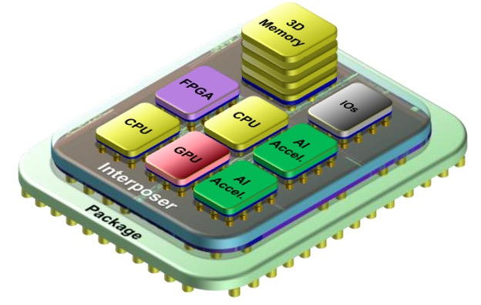
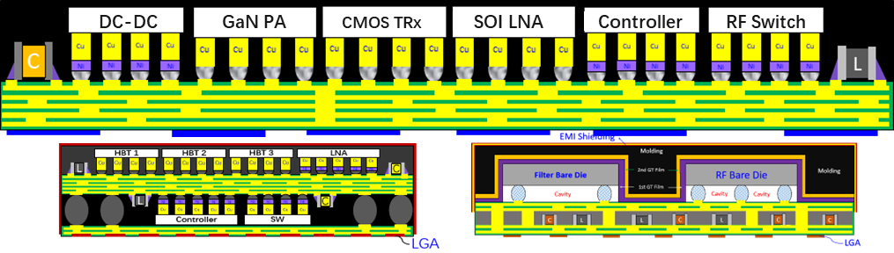
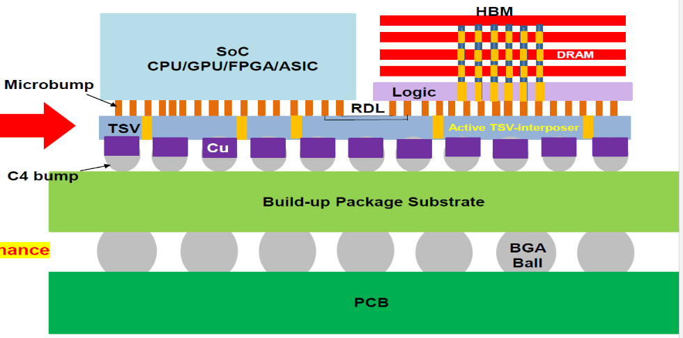

High5 Semi 的解決方案 / 深度技術 / IP
透過異質集成芯粒封裝技術 Heterogeneous Integration of Chiplets 同時解決無線與光通信技術瓶頸，並滿足降低成本的產業需求
By integrating CMOS + GaN we aim to deliver best-in-class energy-efficient solutions for the two highest growth enterprise communication market in the next decade:
High-speed optical communication for Data Center Interconnection (DCI)
Satellite communication for 6G networks
High5 Semiconductor Ltd. Proprietary and Confidential. Protected under NDA. Copyright 2025.

Slide 5
内容綱要
團隊成員與技術協同
市場機遇
技術路綫與目標市場
產品描述與原型
商務拓展

Slide 6
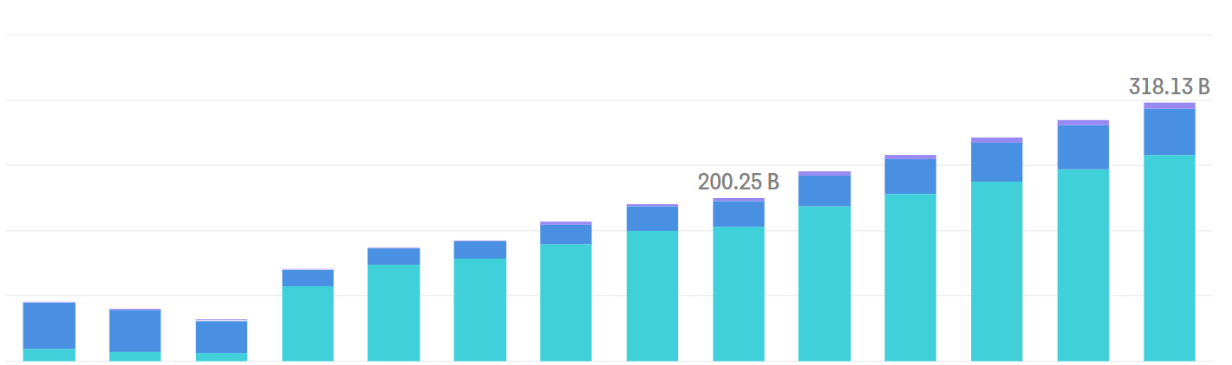
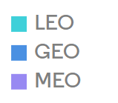


市場機遇 & 總潛在市場 (TAM) 預測
光通信市場規模：
中國與全球其他地區 (單位：USD Million)
全球衛星通信市場規模：
按軌道類型劃分 (單位：USD Billion)
Sales ($B)
For the first stage, optical communication products for DCI, the total addressable market in next 5 years is 40 billion USD
For the second stage, wireless communication products for LEO satellite communication, the total addressable market in next 5 years is 26 billion USD
High5 Semiconductor Ltd. Proprietary and Confidential. Protected under NDA. Copyright 2025.

Slide 7
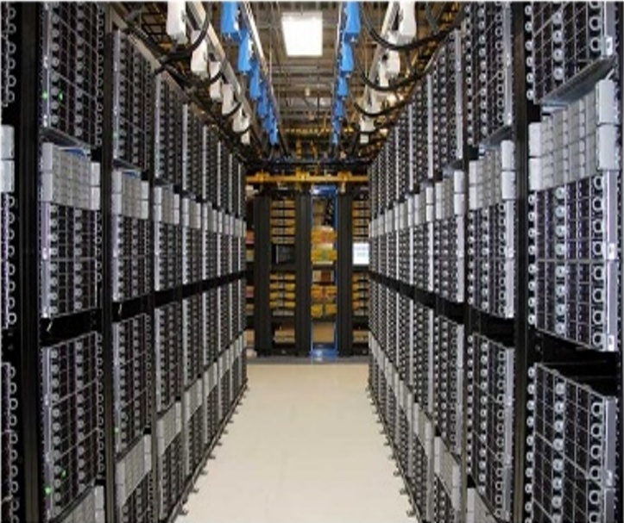
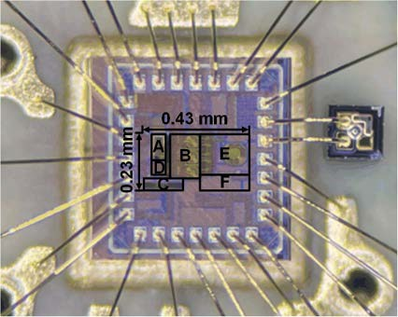
數據中心光通信模塊市場機遇
數據中心互連光模塊
新一代數據中心互連需要高效率、高速的光收發模塊
High5 Semiconductor Ltd. Proprietary and Confidential. Protected under NDA. Copyright 2025.

Slide 8
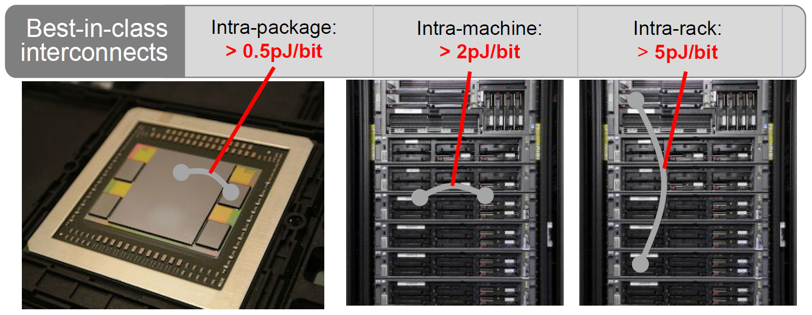
數據中心光通信模塊市場機遇
Interconnect Power and Density Bottleneck
Internal chips are slow, but >50Tb interface to ICs overwhelm packaging density
200Gb/s SERDES take area, yield, and power, all with limited reach
High5 Semiconductor Ltd. Proprietary and Confidential. Protected under NDA. Copyright 2025.

Slide 9
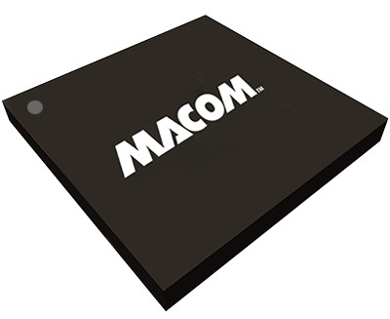
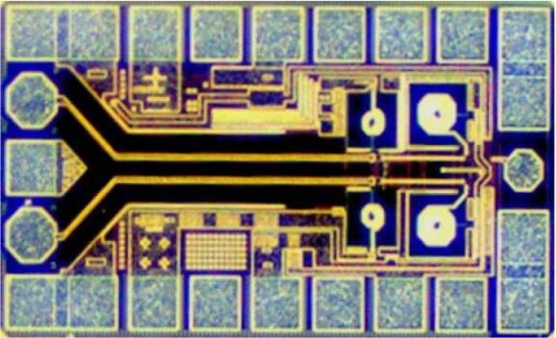
數據中心光通信模塊產品挑戰
AIGC數據中心互連遇到的帶寬瓶頸
Due to the data exchange and transmission requirements brought by AIGC, the market for high-speed optical modules have seen exponential growth
Current optical communication products (InP, SiGe, GaAs) cannot meet high-energy efficient bandwidth and cost requirements
Low-frequency solutions fail for modern data center interconnects
Designing heterogeneous optical chiplets to boost bandwidth and data rates
Targeting 4x bandwidth growth from 200/400G to 1.6T optical modules
Refused to be choked!
拒绝被卡脖子!​​
High5 Semiconductor Ltd. Proprietary and Confidential. Protected under NDA. Copyright 2025.

Slide 10
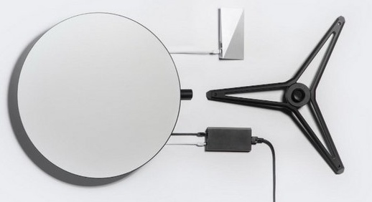
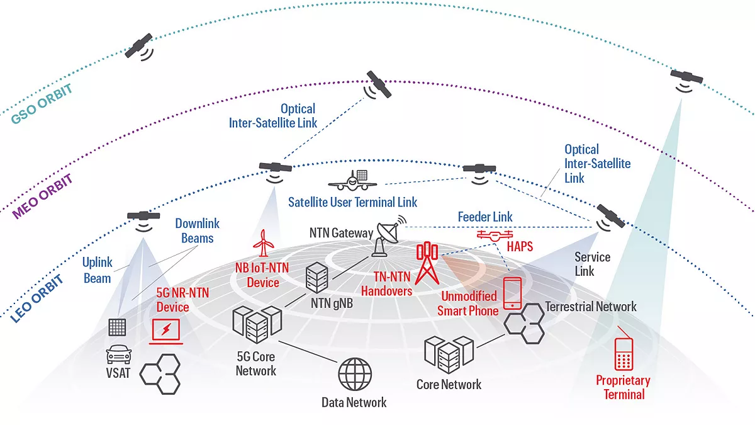
6G衛星通信市場機遇
5 million customers in 2025 for revenue US$3B
6G及未來衛星通信的全球競賽：
有限的頻譜資源與傳輸容量
LEO capacity limit: < 100K satellites
China's opportunity: Must develop a Starlink-level solution to ensure global competitiveness in satellite internet
ITU rules: "First come, first served", escalating the race
High5 Semiconductor Ltd. Proprietary and Confidential. Protected under NDA. Copyright 2025.
Notes:
LEO can safely accommodate only 60,000 to 100,000 satellites
Intense global competition for these limited orbital and frequency resources
The International Telecommunications Union (ITU) operates on a "first come, first served" basis, escalating the race
Current CMOS-based transceivers and digital processing solutions lack the needed output power for LEO communication: 10,000x short of requirements

Slide 11
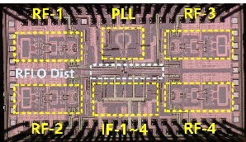
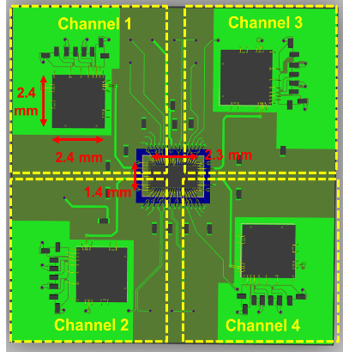
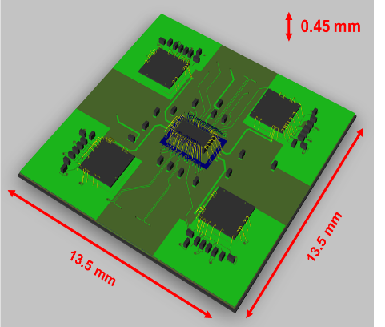
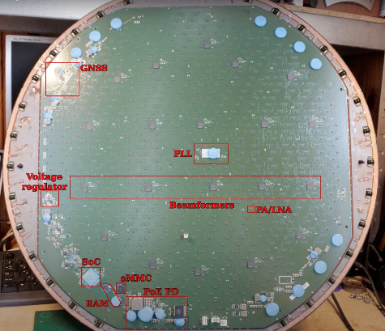
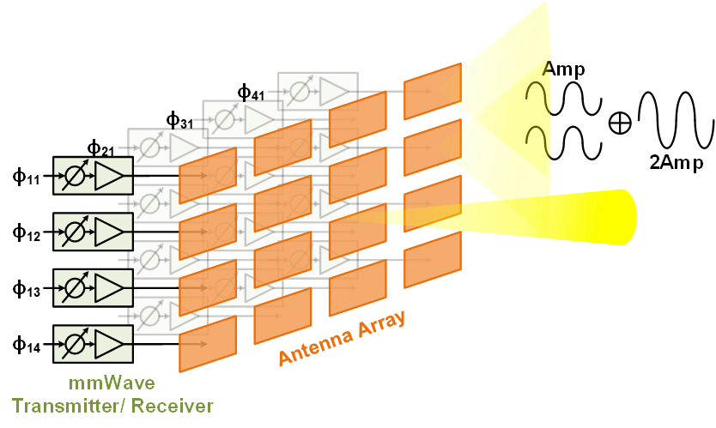
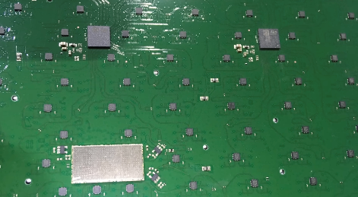
6G衛星通信產品挑戰
當前市場領導者 : StarLink Satcom
CMOS phased array circuits: 10~20x power enhancement
Mechanical satellite tracking
Electrical and digital beamforming
Combining individual PAs and LNAs for gain enhancement
Long-distance inter-satellite communication requires high-end eco-semiconductors
High-integration CMOS circuit array
High-energy-efficiency GaN power amplifiers
Heterogeneous chiplet packaging technology
GaN technology: 10~50x power boost with high-voltage operation
Overall 1,000x Power Increase!
Unprecedent Performance in Integration/Power/Efficiency/Cost!
High5 Semiconductor Ltd. Proprietary and Confidential. Protected under NDA. Copyright 2025.

Slide 12
内容綱要
團隊成員與技術協同
市場機遇
技術路綫與目標市場
產品描述與原型
商務拓展

Slide 13
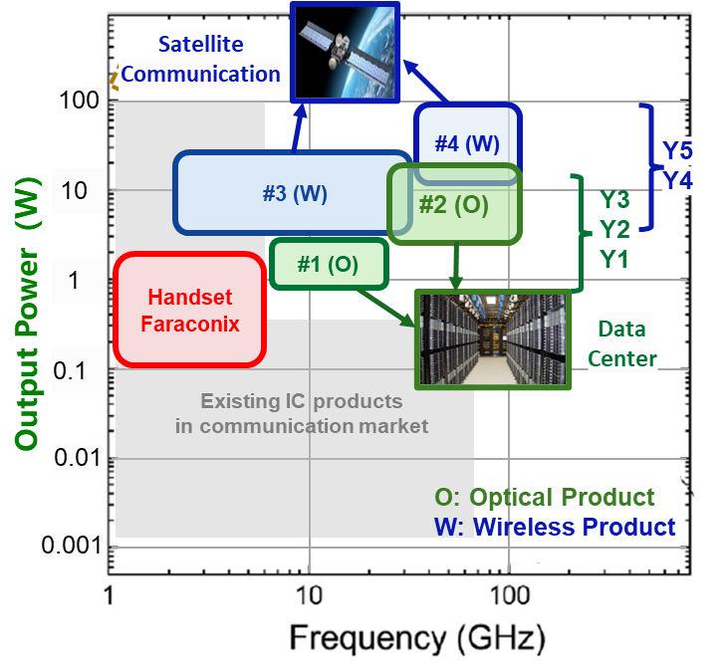
High5 CMOS+GaN 無線與光通信技術路線圖概覽
Stage | Key Deliverables
RAISe+ Stage 1 R&D focusing on optical chiplet module (Year 1~3, 2026~28) | Performance analysis of (CMOS+GaN) materials
 | Initial design and prototype of (CMOS+GaN) HiSiP for data center interconnection
 | Prototype for short-reach 1-2 Tb/s links
RAISe+ Stage 2 Commercialization (Year 4~5, 2029~30) | Mass production of optical communication products
 | Design (CMOS+GaN) chiplets for 6G satellite communication
 | Compliance with 3GPP Release 18 and Chinese satellite standards
High5 Semiconductor Ltd. Proprietary and Confidential. Protected under NDA. Copyright 2025.

Slide 14
内容綱要
團隊成員與技術協同
市場機遇
技術路綫與目標市場
產品描述與原型
商務拓展

Slide 15
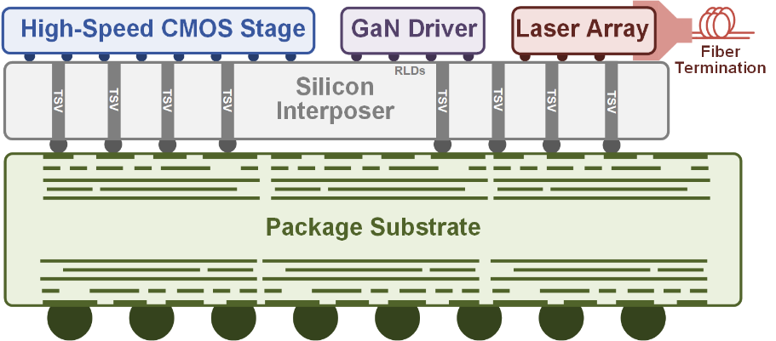
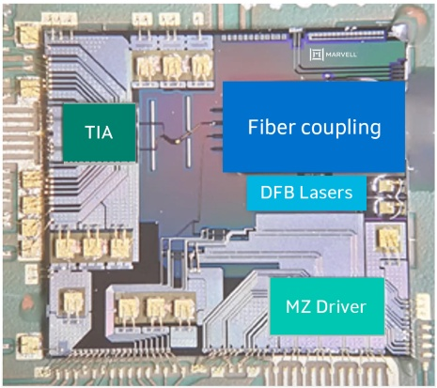
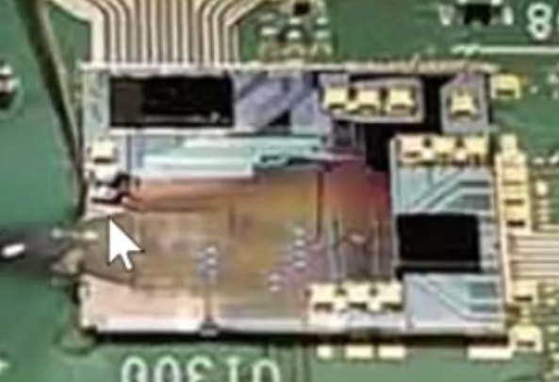
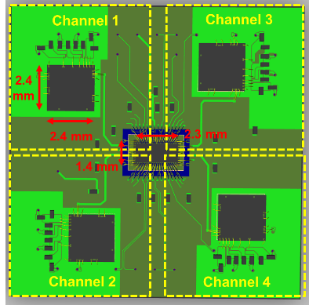

產品描述: CMOS + GaN Chiplet HiSiP
數據中心互聯的光通信異質集成芯粒
衛星通信的無線異質集成芯粒
Cross section of the optical chiplet in package
Cross section of the wireless chiplet in a package
Integrated optical module (source: Marvell)
3D Layout of the wireless chiplet in a package
High5 Semiconductor Ltd. Proprietary and Confidential. Protected under NDA. Copyright 2025.

Slide 16
CMOS 產品原型：48-Gb/s PAM-4 Optical Receiver
Fabricated in 28-nm bulk CMOS
1308-nm light source is coupled to PD through a single-mode fiber
Optical power level is adjusted by an internal optical attenuator
Deserialized MSB and LSB are sent to off-chip BER testing
C. Zhang, C.P. Yue et al., VLSI 2024, Honolulu, HI, USA.
9/28/2025
16
High5 Semiconductor Ltd. Proprietary and Confidential. Protected under NDA. Copyright 2025.

Slide 17
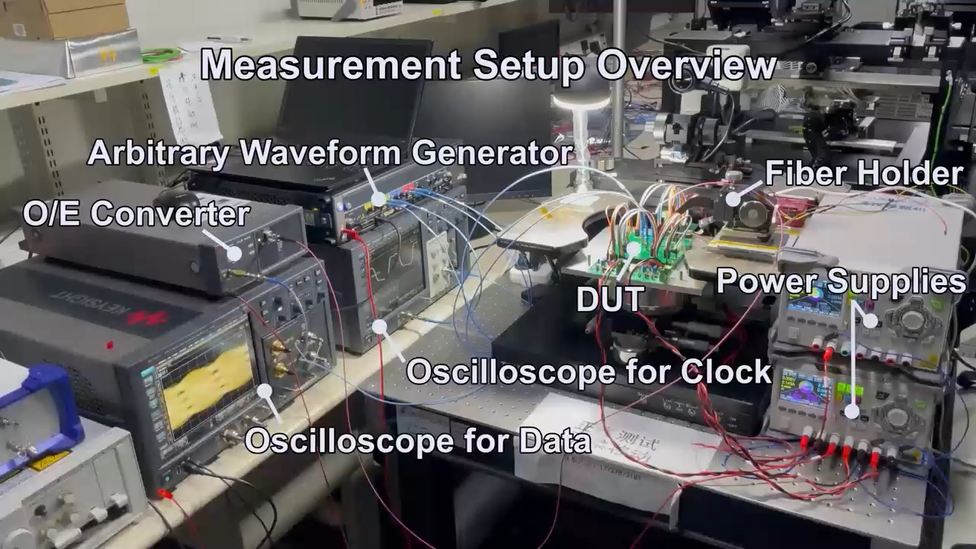
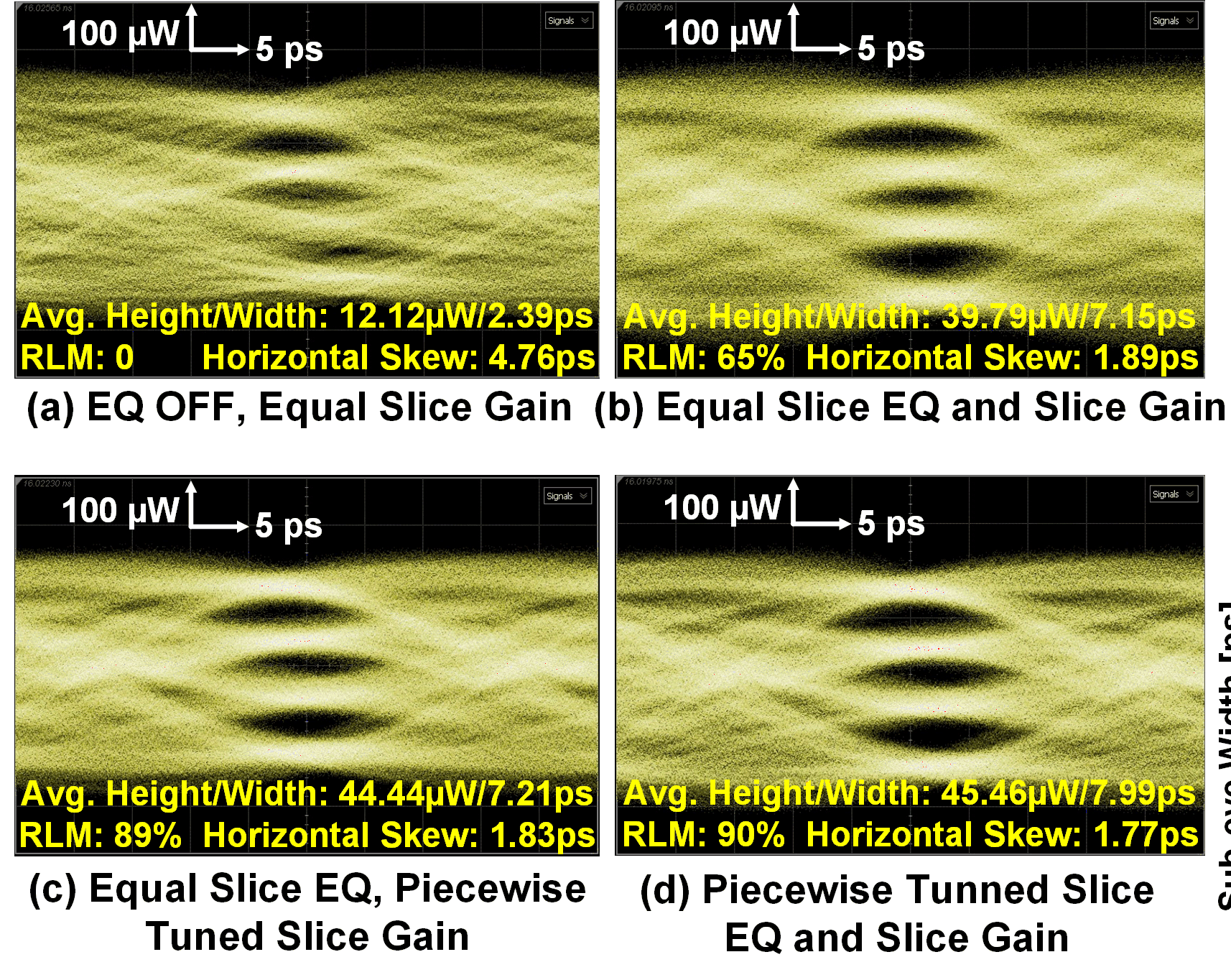
CMOS 產品原型：56-Gb/s PAM-4 Optical Transmitter
Data path: thermometer-coded architecture
Clock path: Wideband PLL and cascading VCDL
Optical part: Wire-bonded anode-driven VCSEL
F. Chen and C. P. Yue, ESSCIRC 2023, Lisbon, Portugal.
9/28/2025
17
High5 Semiconductor Ltd. Proprietary and Confidential. Protected under NDA. Copyright 2025.

Slide 18
CMOS 產品原型：60-Gb/s CDR with Jitter Compensation
60-Gbps PAM-4 Receiver with Jitter Compensation CDR
Prototyped in 40nm CMOS
Core area: 0.2 mm²
30-60-Gb/s PAM-4 Receiver with Jitter Compensation CDR System Diagram
Complementary Signal Generator
The receiver integrates a Clock and Data Recovery (CDR), capable of detecting the phase and amplitude of the input jitter and generating a complementary jitter to negate the jitter transfer.
L. Wang, Z. Zhang, C. Wang, R. Azmat, W. Shi and C. P. Yue, "A 60-Gb/s 1.2-pJ/bit 1/4-Rate PAM-4 Receiver With a Jitter Compensation CDR," in IEEE Journal of Solid-State Circuits, vol. 59, no. 2, pp. 449-463, Feb. 2024
9/28/2025
18
High5 Semiconductor Ltd. Proprietary and Confidential. Protected under NDA. Copyright 2025.

Slide 19
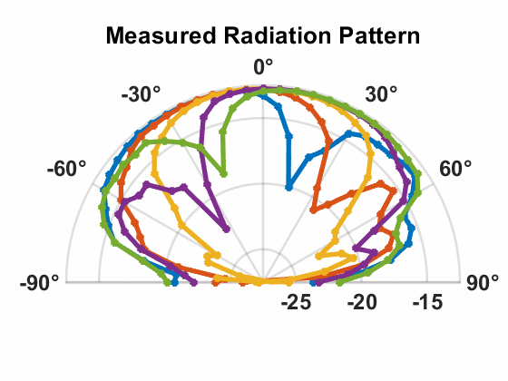
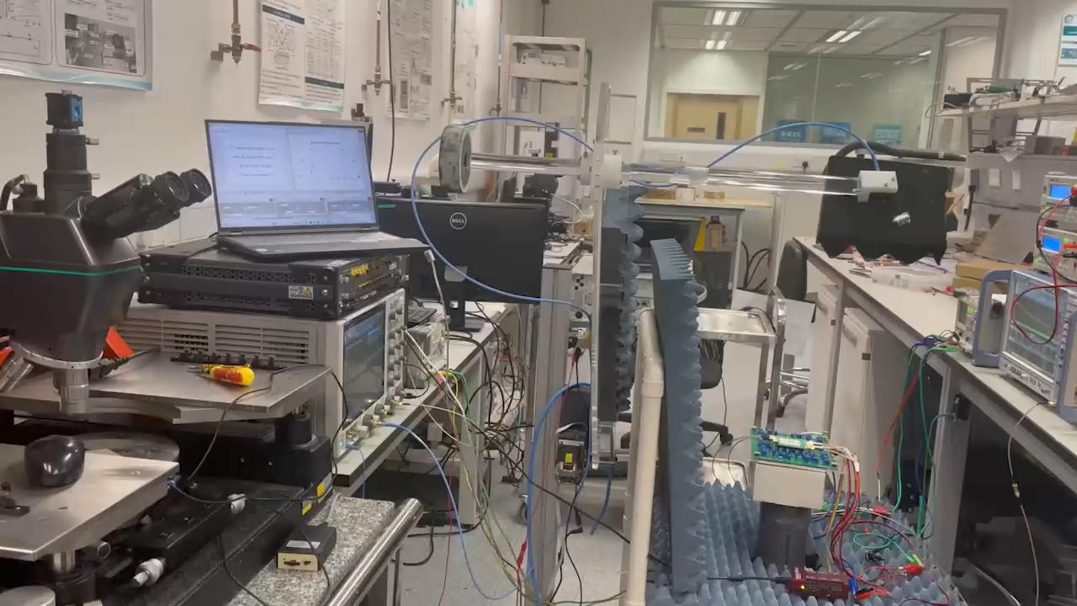
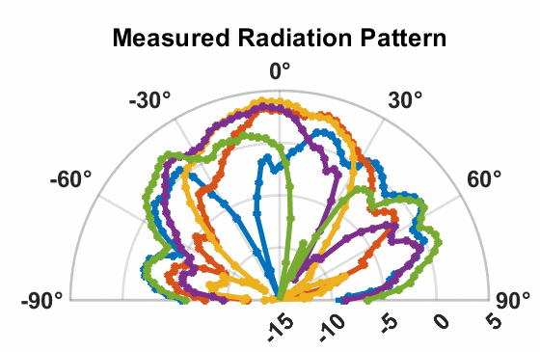

CMOS 產品原型：28GHz Phased-array Beamformer
Beamsteering Demo
9/28/2025
High5 Semiconductor Ltd. Proprietary and Confidential. Protected under NDA. Copyright 2025.
19

Slide 20
CMOS 產品原型：20–24-GHz Sub-Sampling PLL
22-GHz Compact, Low-Jitter Dual-path Sub-Sampling Phase-Locked Loop
Total Chip Area: 0.126 mm²
Core Area: 0.057 mm²
System architecture of the proposed DPSSPLL
A low-noise charge-domain gain control technique provides a bandwidth tuning range greater than 30 dB, with noise contribution less than 3 fs
The design achieves a compact area (0.057 mm²) and ultra-low jitter (61.23 fs), making it highly suitable for integration into phased array systems
L. Wang, Z. Liu, R. Ma and C. P. Yue, "A Compact 20–24-GHz Sub-Sampling PLL With Charge-Domain Bandwidth Control Scheme," in IEEE Journal of Solid-State Circuits, vol. 60, no. 3, pp. 768-784, March 2025
9/28/2025
20
High5 Semiconductor Ltd. Proprietary and Confidential. Protected under NDA. Copyright 2025.

Slide 21
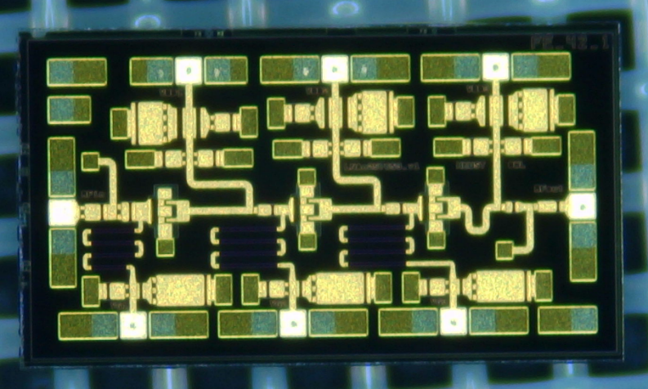
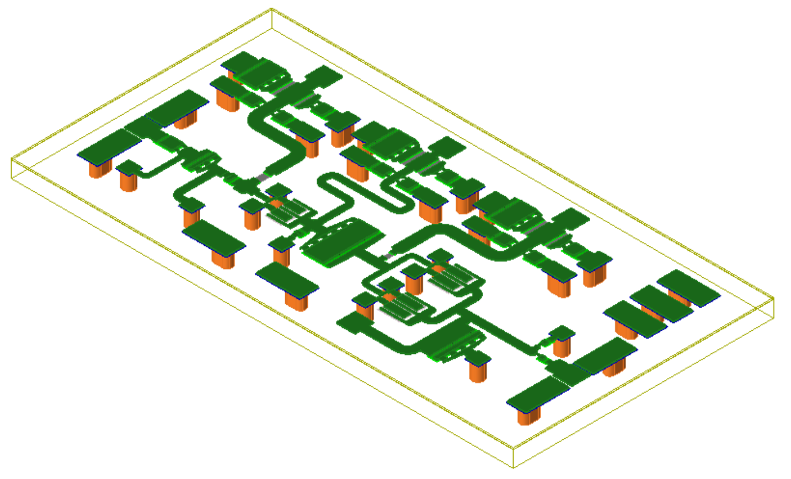
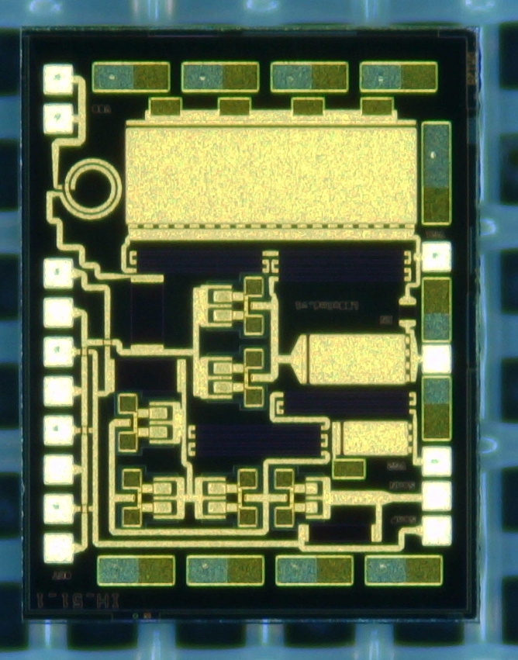
GaN 產品原型: PA, LNA, Laser Diode Driver
Fig. b
Copper Pillar Bumps for Flip-chip Bonding
Fig. a
Top-view of a GaN low-noise Amplifier (LNA) chip with bumps
Top-left view of a GaN power amplifier (PA) chip with bumps
Top-view of a GaN laser diode driver (LDD) chip with bumps
Fig. c
9/28/2025
21
High5 Semiconductor Ltd. Proprietary and Confidential. Protected under NDA. Copyright 2025.

Slide 22
先進封裝產品原型：Chip-to-antenna-on-PCB Design
Antenna array
4 flipped patches, 4 dummy patches
Flipped patch driven by differential signals
Dummy patches are ground
EM model of patch antenna on PCB
Photo of the top side (chip) and back side (antenna)
Z. Liu, L. Wang, R. Ma, Z. Chen and C. Patrick Yue, "A Compact 28-GHz Transmitter Front End With Co-Optimized Wideband Chip–Antenna Interface," in IEEE Transactions on Microwave Theory and Techniques
9/28/2025
22
High5 Semiconductor Ltd. Proprietary and Confidential. Protected under NDA. Copyright 2025.

Slide 23
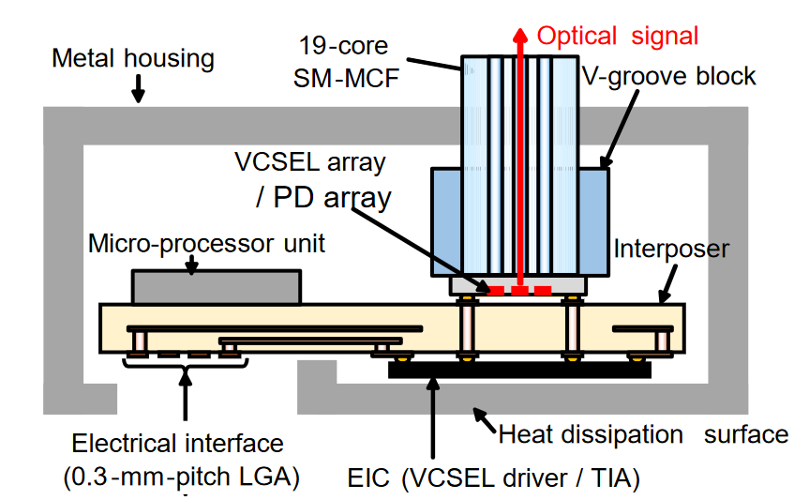
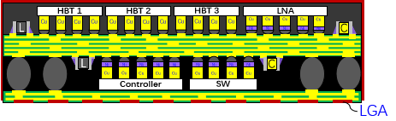
先進封裝產品原型: Interposer Substrate Design
HEMT
PA
CMOS TRx
PCB
Dual-side Interposer for Wireless Satcom
Double-sided flip-chip-bonding
Passive components in the middle layer of the interposer for matching, filtering, etc.
Front-end modules on the top side
CMOS chiplets on the back side
Solder balls to connect the interposer to the PCB
Patch antennas will be designed on PCB
Dual-side Co-Packaged Optics (CPO)
Double-sided flip-chip-bonding
Direct Multi-Core Fiber (MCF) buttom-coupling
Core-less organic build-up interposer (thinner)
9/28/2025
23
High5 Semiconductor Ltd. Proprietary and Confidential. Protected under NDA. Copyright 2025.

Slide 24
内容綱要
團隊成員與技術協同
市場機遇
技術路綫與目標市場
產品描述與原型
商務拓展

Slide 25











產品競爭力 / 市場格局
Competitive Analysis | Area | Company | Product Descriptions
Optical Communication Products for DCI | Domestic |  | 100G/400G/800G optical modules, optoelectronic chips, lasers, etc.
 | Global |  | High-speed optical modules (400G/800G), optoelectronic chips (CPO), PAM4 chips, high-speed DSP chips
Wireless Products for Satellite Communication | Domestic |  | Satellite ground equipment, inter-satellite communication modules, RF front-end chips, low-earth orbit satellite terminals
 | Global |  | Satellite communication terminals, low-earth orbit satellite networking systems, RF front-end modules, high-speed ADC/DAC chips
High5 Semiconductor Ltd. Proprietary and Confidential. Protected under NDA. Copyright 2025.

Slide 26
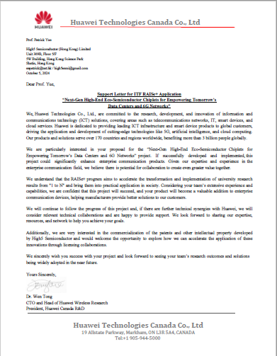
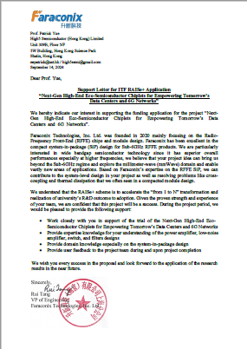

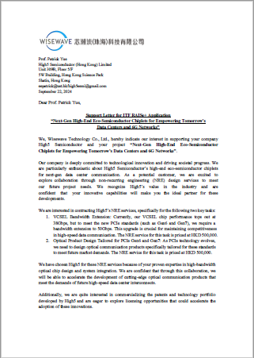

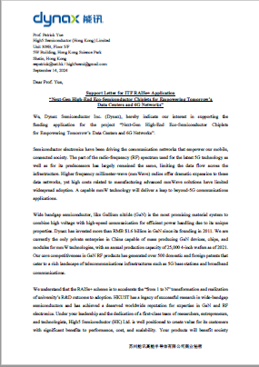

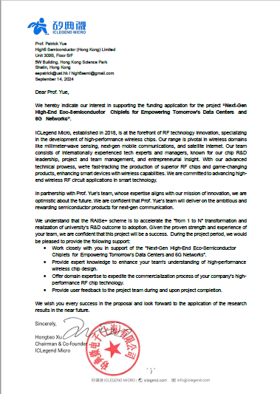
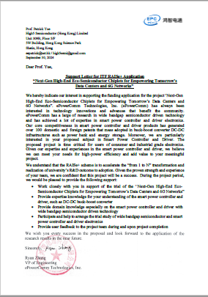




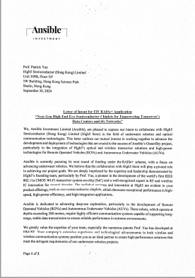
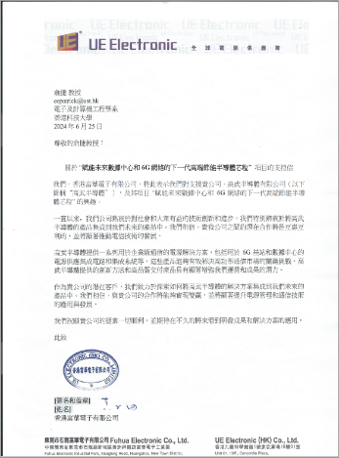
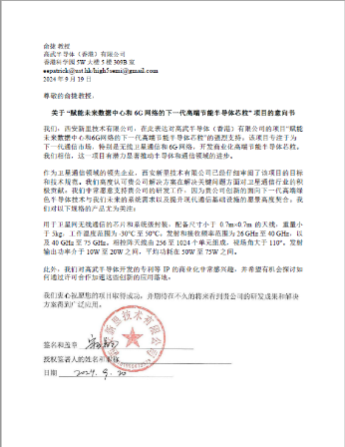
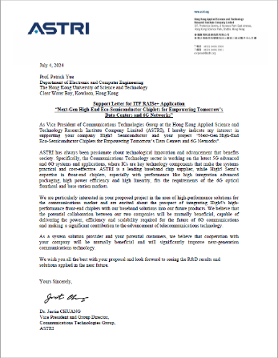
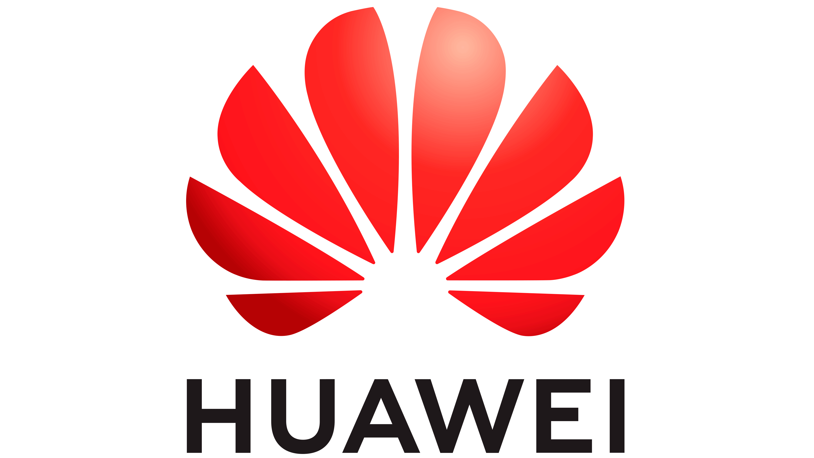

與 RAISe+ 相關的合作夥伴及背書支持
Packaging Partner
Other Partners
GaN Partner
6 technology R&D partners
Investors and Customers
4 engaged customers
High5 Semiconductor Ltd. Proprietary and Confidential. Protected under NDA. Copyright 2025.

Slide 27
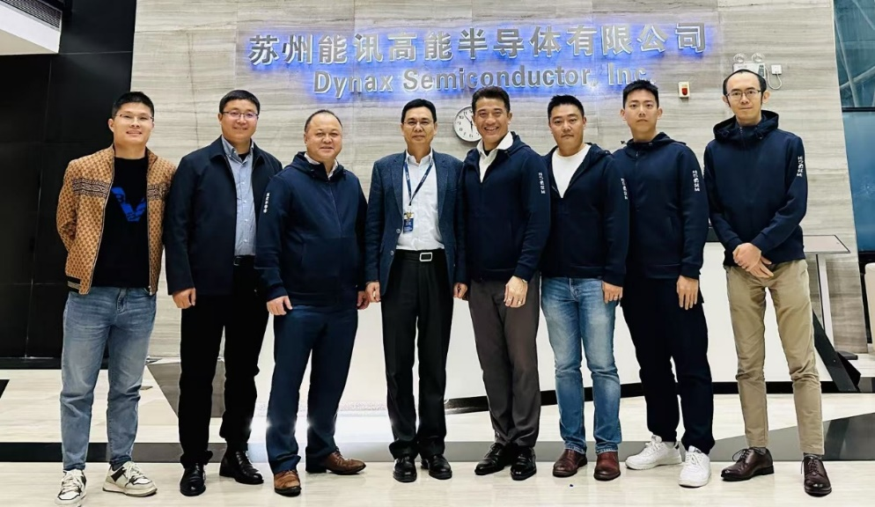
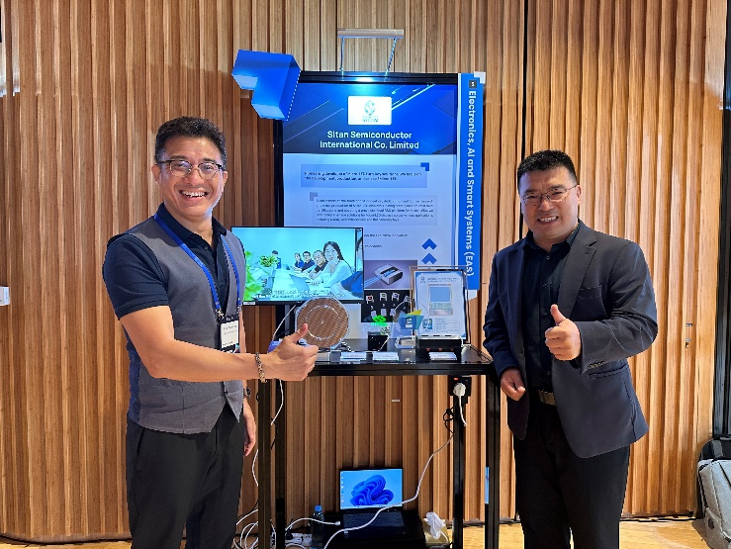





與 GaN 行業建立戰略合作夥伴關係
與 GaN 代工夥伴 Dynax (蘇州能訊高能半導體)
與 GaN & micro-LED 代工夥伴 Sitan (思坦科技）
High5 Semiconductor Ltd. Proprietary and Confidential. Protected under NDA. Copyright 2025.

Slide 28






總部設立於香港科學園（HKSTP）
在香港註冊並設立辦公室
由香港投資推廣署（InvestHK）支持
High5 Semiconductor Ltd. Proprietary and Confidential. Protected under NDA. Copyright 2025.

Slide 29





傳媒廣汎關注與報道
獲批港府創新科技署(ITC)產學研1+(RAISe+)資助，受到傳媒廣汎關注
香港電臺
RTHK
信報
HKEJ
星島日報
華僑報
大公報
明報
High5 Semiconductor Ltd. Proprietary and Confidential. Protected under NDA. Copyright 2025.

Slide 30

Acknowledgements (HKUST OWL🦉Alumni)

Slide 31

Acknowledgements (HKUST OWL🦉Current Members)

Slide 32

Thanks! 謝謝!
High5 Semiconductor (HK) Limited 高武半導體(香港)有限公司
high5semi@gmail.com
https://high5semi.github.io/
Optical Wireless Lab
Department of Electronic and Computer Engineering
The Hong Kong University of Science and Technology (HKUST)
Hi5 Semi
High5 Semiconductor (Hong Kong) Limited
高武半導體(香港)有限公司

